Slide 1
Succinct
de Bruijn Graphs
Alex Bowe

Slide 2
Overview
Sequencing and de Bruijn Graphs
Succinct de Bruijn Graphs (“BOSS”)
Variable Order de Bruijn Graphs
Coloured de Bruijn Graphs
Notes:
- seq: read into comp
most common way to use the sequencing data
our way of reducing memory use

Slide 3
Overview
Sequencing and de Bruijn Graphs
Succinct de Bruijn Graphs (“BOSS”)
Variable Order de Bruijn Graphs
Coloured de Bruijn Graphs
+ External construction + Larger experiments (scales well!) + 30% more time to construct, 3.5x bigger + Same peak RAM + HDD + Submitted to Bioinformatics TCBB (Aug 1)
+ Implemented with sparse matrix + 18TB (Cortex) -> 245 GB RAM + Submitted to Bioinformatics (Sep 12) + Resubmit after some small changes (Nov 9)
Notes:
small changes: experiments on k, single core, etc
Havent heard back from TCBB

Slide 4
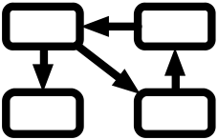
Shotgun sequencing
Objective: Read genome into computer (~3.2 billion bases)
Problem: molecule too small to read entirely
Solution: Break it into random overlapping “short reads”
Algorithms required to assemble these back in the (close to) correct order
genomic DNA
Clone (for overlaps)
acgt
overlapping
genomes
“Shotgun Sequencing”
randomly overlapping
reads
(~100 bases)
Graph Construction
de Bruijn graph
Graph Traversal
contigs + gaps
Notes:
most common way at the moment of getting…
make use of chemical and photographic methods

Slide 5
What about nanopore?
Will this research be made redundant? No.
High error rate: ~15%
Petabytes (Exabytes?) of short read data - non-economical to waste, will take decades to analyse all of it (common opinion)
Medvedev - Paired ends (with insert size) at least as good as long reads.
Notes:
Pevzner and other leading researchers

Slide 6
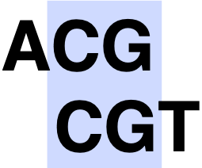
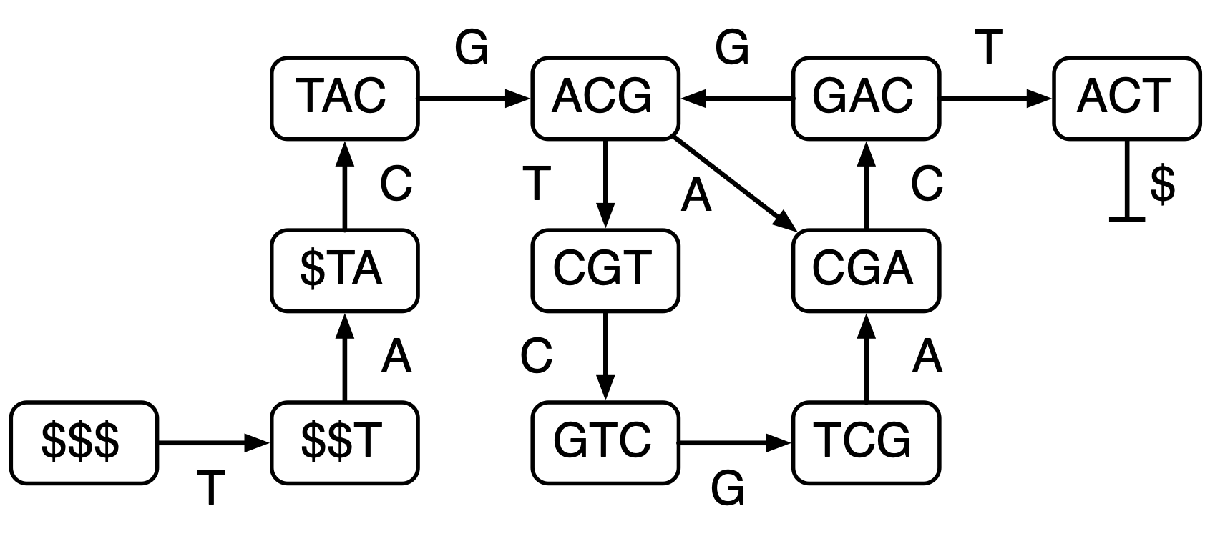
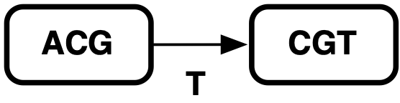
de Bruijn graphs
T = TACGACGTCGACT
sequencing read
extract overlapping kmers
(fixed k-length substrings)
edge if k-1 overlap
Traversal methods differ, but proposed as finding Eulerian path [Pevzner et al. 2001]

Slide 7
Succinct
de Bruijn Graphs
Alex Bowe, Taku Onodera, Kunihiko Sadakane, and Tetsuo Shibuya

Slide 8
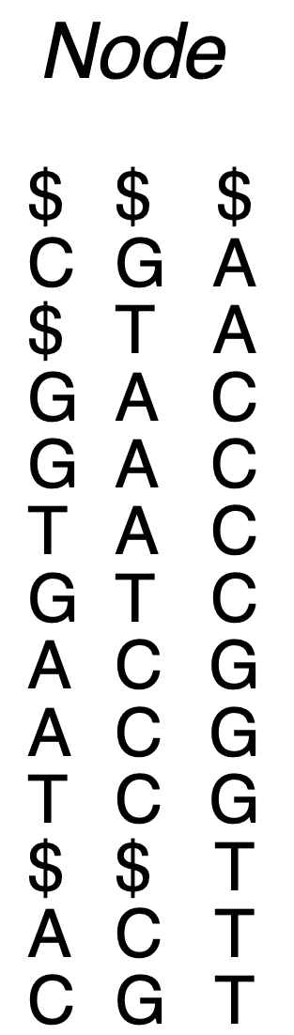
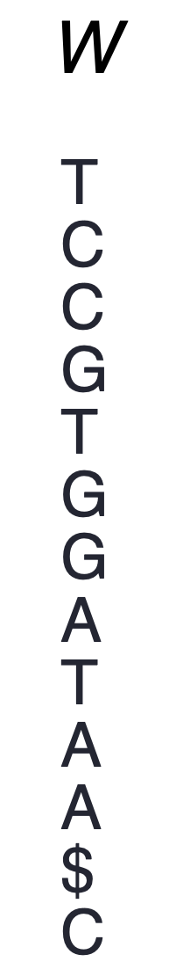
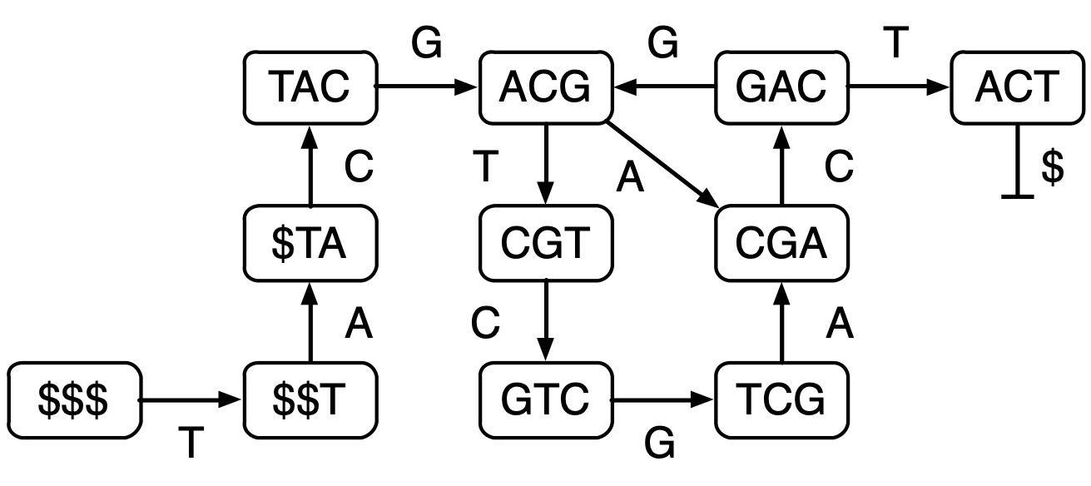
Construction
T = $$$TACGACGTCGACT$
Notes:
Add dummy edges to ensure every node has an incoming and an outgoing edge - maintain occurrences and relative sorted order in each col

Slide 9
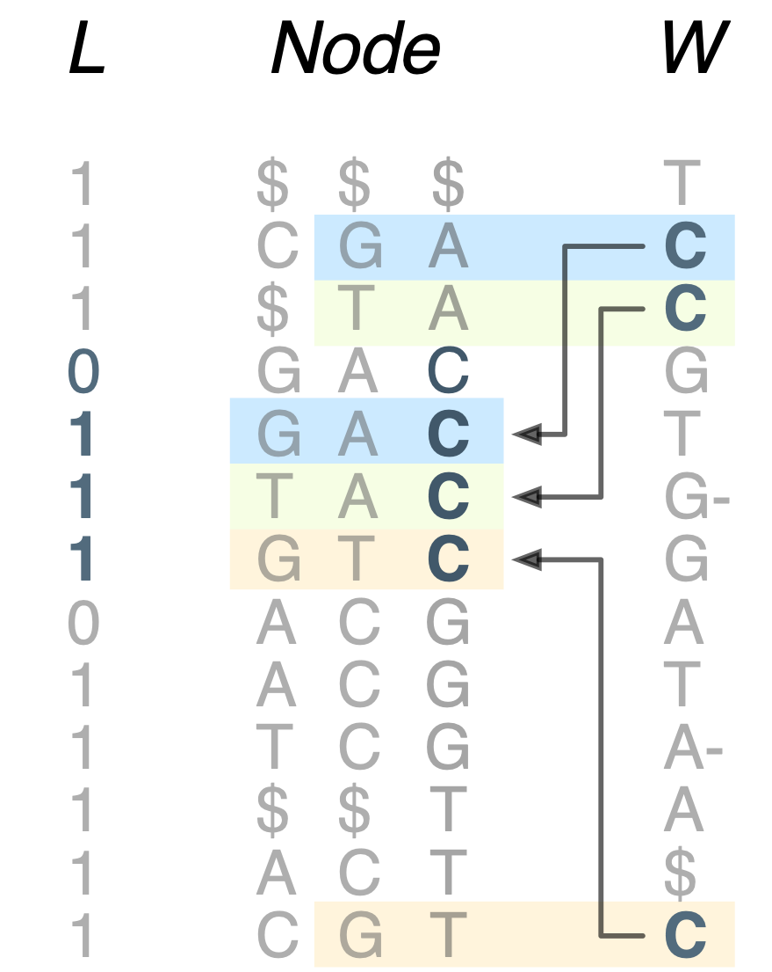
Construction
T = $$$TACGACGTCGACT$
Notes:
relative sorted order means we can follow edges by counting

Slide 10
Construction
select
T = $$$TACGACGTCGACT$
rank
Notes:
O(1) using rank and select

Slide 11
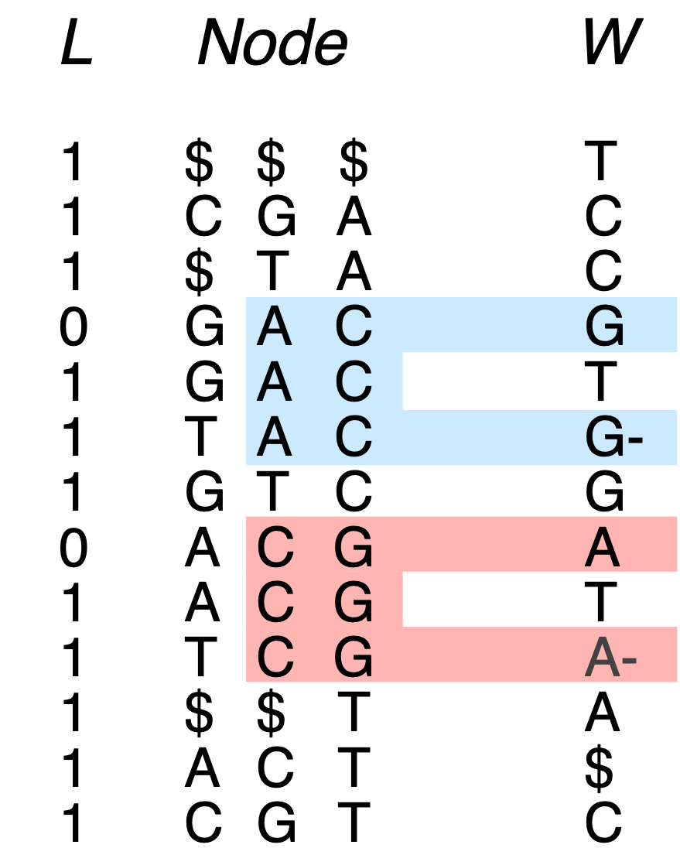
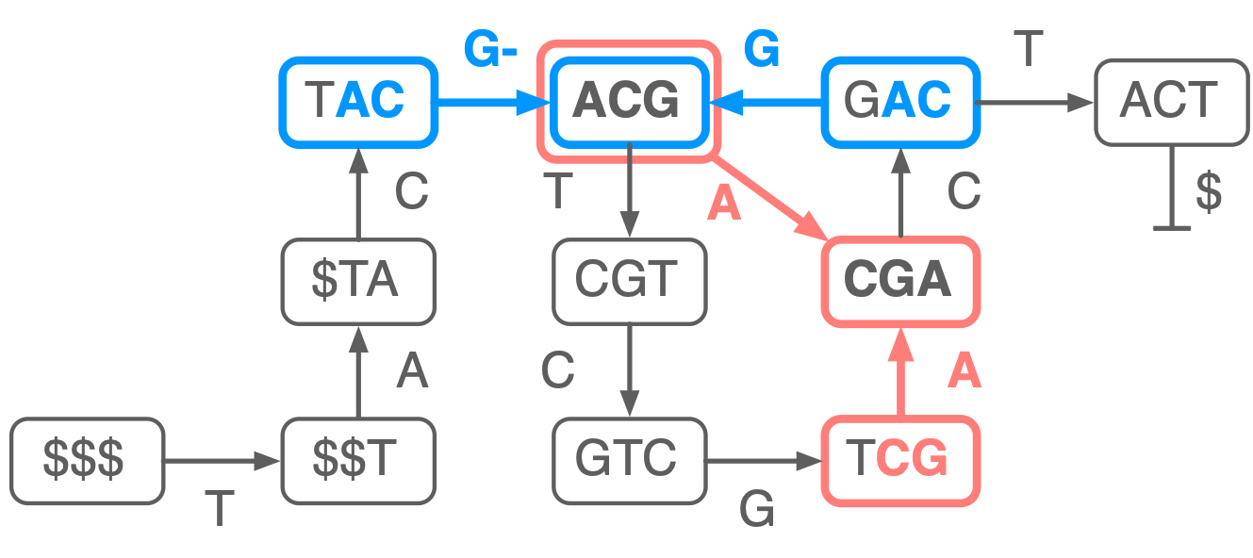
Construction
Set bits mark last row of node
Minus flags differentiate between incoming edges to same node
T = $$$TACGACGTCGACT$
Notes:
- add bit vector to distinguish nodes (which are ranges)
- corresponds to these incoming edges
- distinguishing these is important for other operations

Slide 12
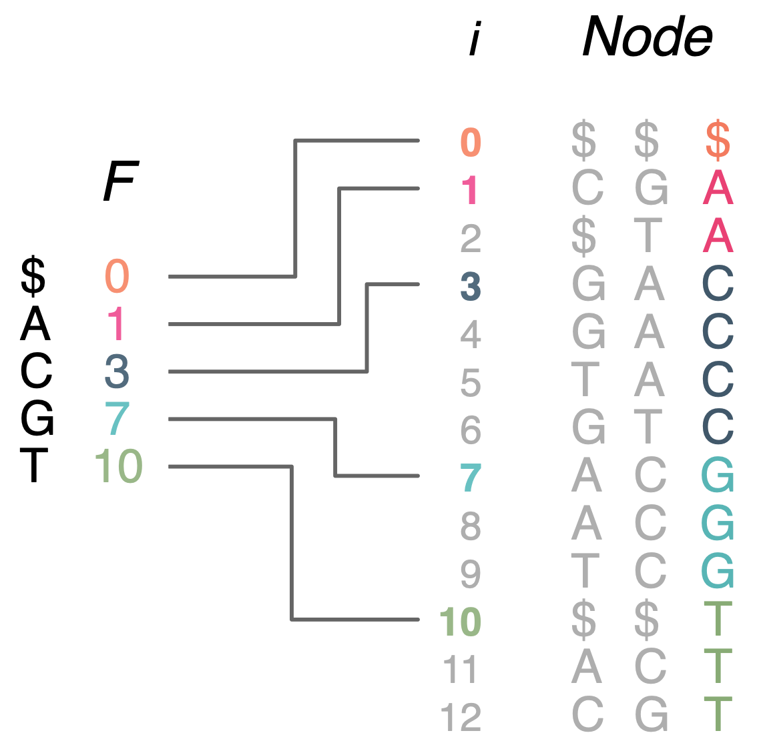

Construction
cyclic property: don’t need to store full node labels
just last two columns (to count)
can store first positions
Notes:
Only store edges, order defines the context

Slide 13
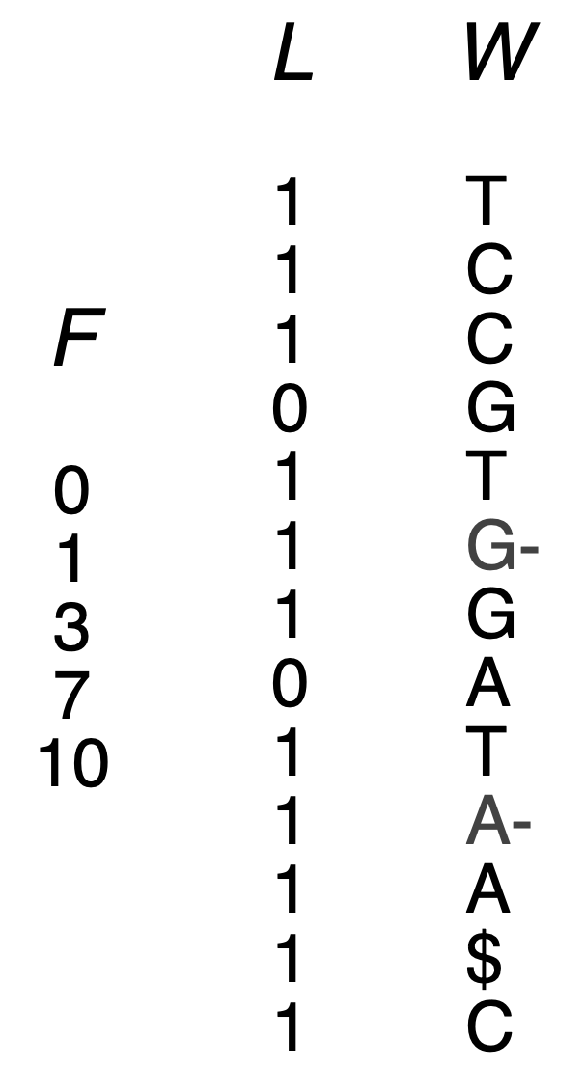
In Total
for m edges:
σ log(m) bits
m log(2σ) = m + m log(σ) bits
m bits
Total: 2 + log(σ) + o(1) bits per edge = 4 bits for DNA (~2 compressed)

Slide 14
Results: Size
Assembler | Approach | Bits per edge
ABySS [Simpson et al. 2009] | Distributed hash table | ~300
Gossamer [Conway et al. 2012] | Succinct bit vector | 28.5
[Pell et al. 2011] | Bloom filter w/ false pos. edges | 4~9
Minia [Cikhi, Rizk 2012] | Bloom filter w/ aux. struct | 13.5
Ours | BWT-inspired w/ succinct rank/select indices | 4 + o(1) (~2 after compression)
Depending on k (here k = 27)

Slide 15
Results: Time
human genome (NA18507)
Assembler | Gigabytes total | Time total
ABySS [Simpson et al. 2009] | 336 GB | 15 hours
Gossamer [Conway et al. 2012] | 32 GB | 50 hours
[Pell et al. 2011] | N/A | N/A
Minia [Cikhi, Rizk 2012] | 5.7 GB | 23 hours 6.4 hours for traversal
Ours | 2.5 GB | 120 hours 4.5 hours for traversal
k = 27
While Minia takes around 23 hours, ours takes 120 hours
because we use an unoptimised k-mer counting method.
m = 5.3 billion
Notes:
Outdated, still running tests on new version minia and new version of ours

Slide 16
Variable Order
de Bruijn Graphs
Alex Bowe, Christina Boucher, Travis Gagie, Simon J. Puglisi, Kunihiko Sadakane

Slide 17
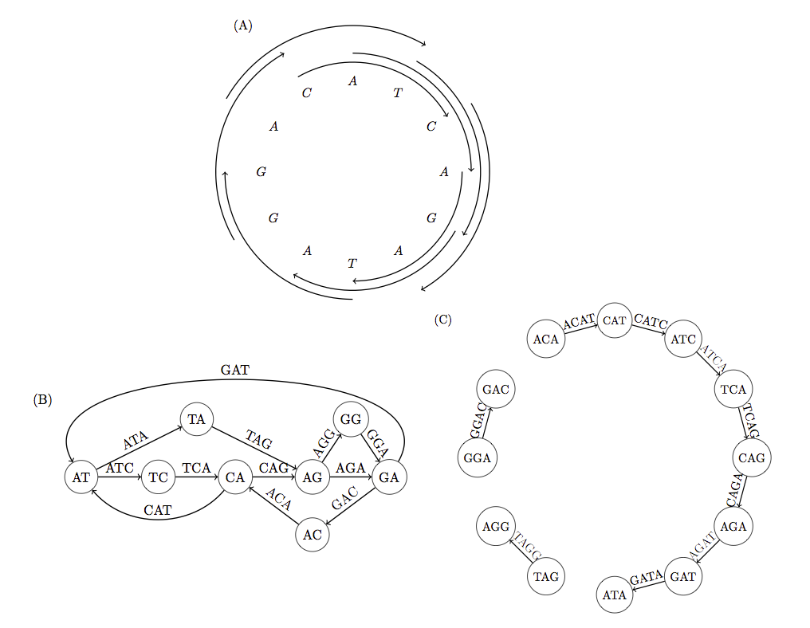
Coverage is not uniform
high coverage
Reads
low coverage
k = 4 dBG
tangled (8 contigs)
fragmented (3 contigs)
k = 3 dBG
Notes:
Trade off in deciding k

Slide 18
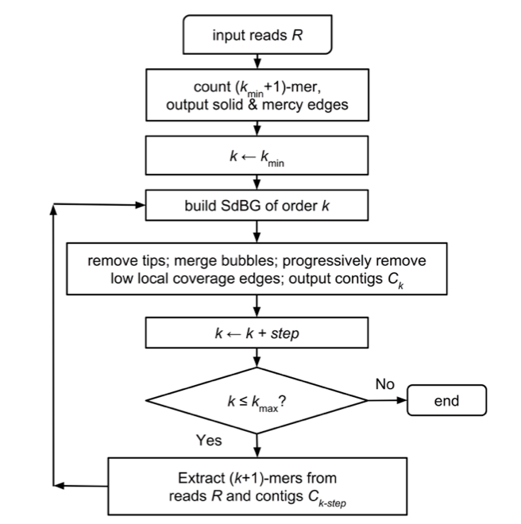
Iterative de Bruijn graphs
factor t slowdown (for t steps of k)
Notes:
- Process reads many times - one of slowest parts
- step != 1 (which would be better)

Slide 19
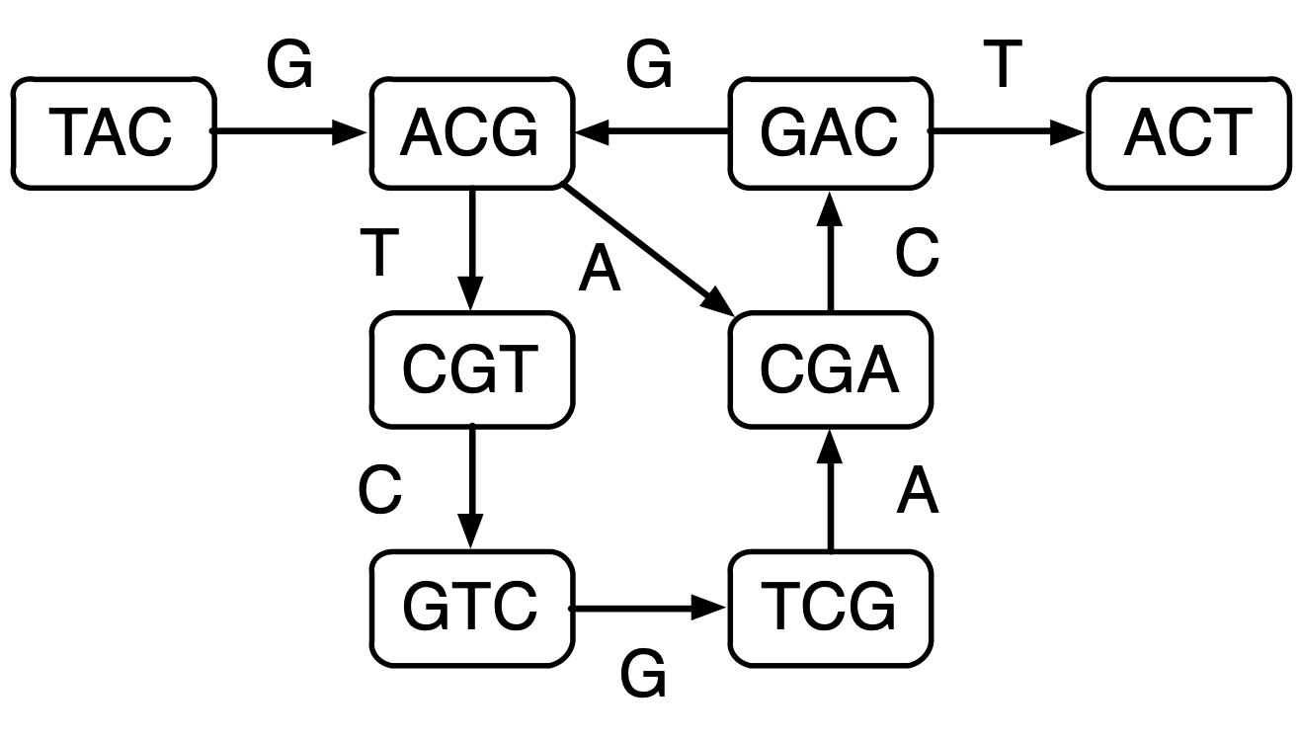
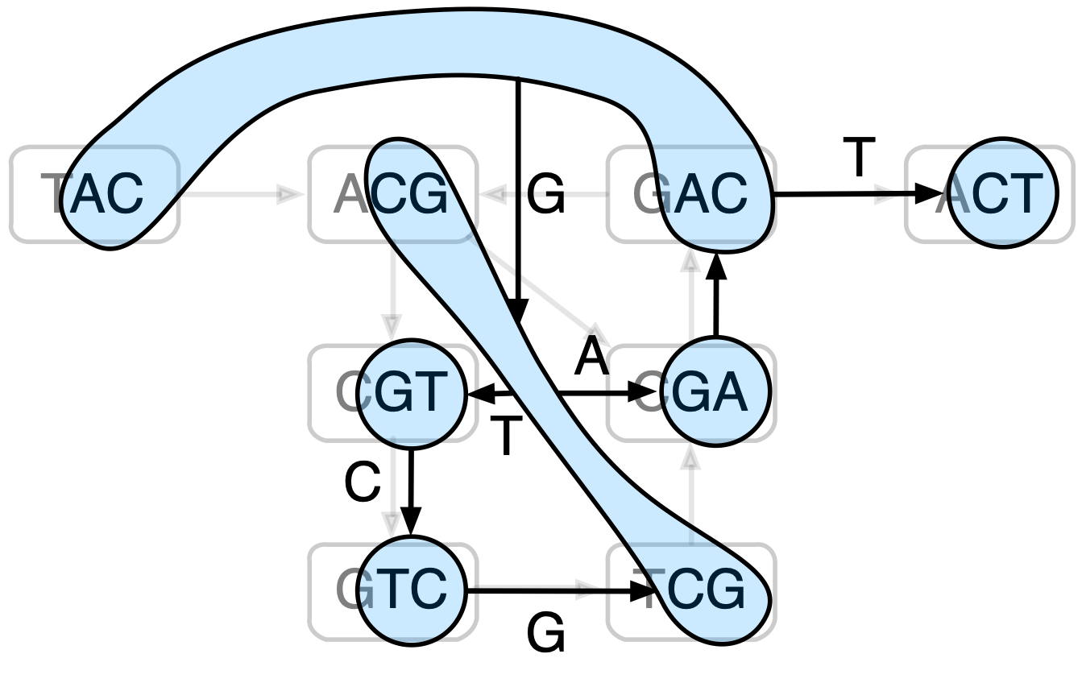
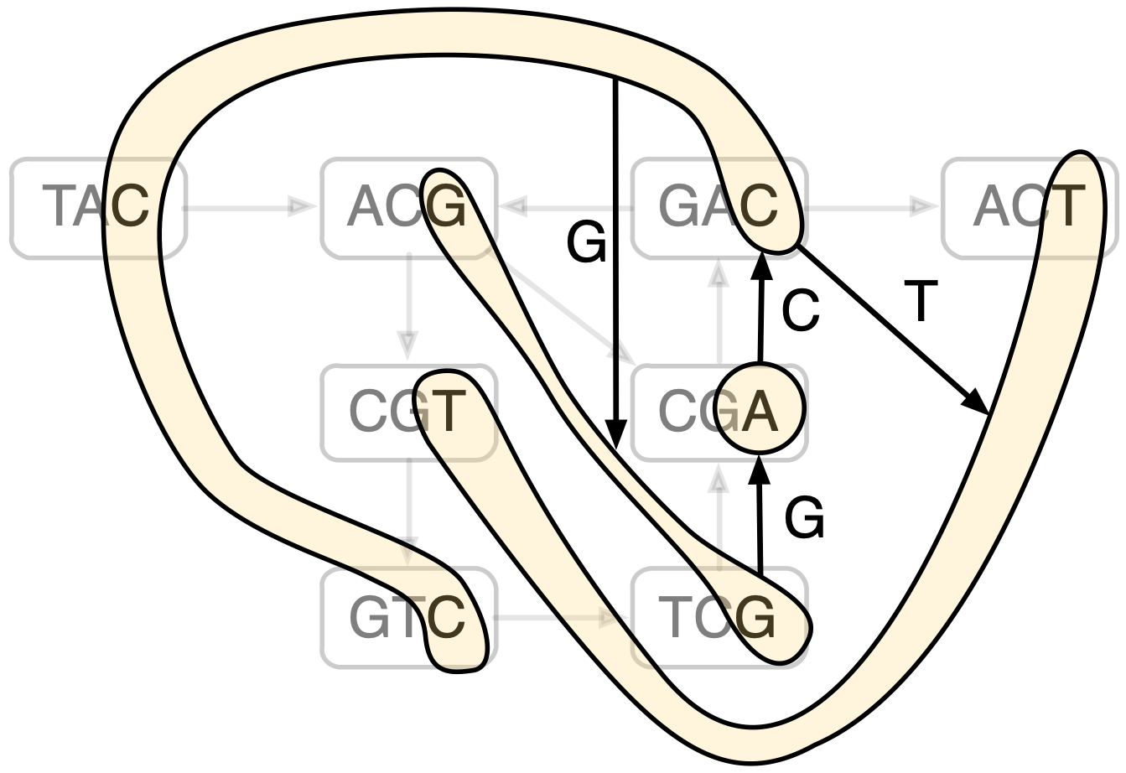
Variable-order de Bruijn graphs
Unfold
Fold
Fold
Unfold
Fold
Unfold
Notes:
succinct, on the fly, any k
construct graph only once: avoid t slowdown

Slide 20
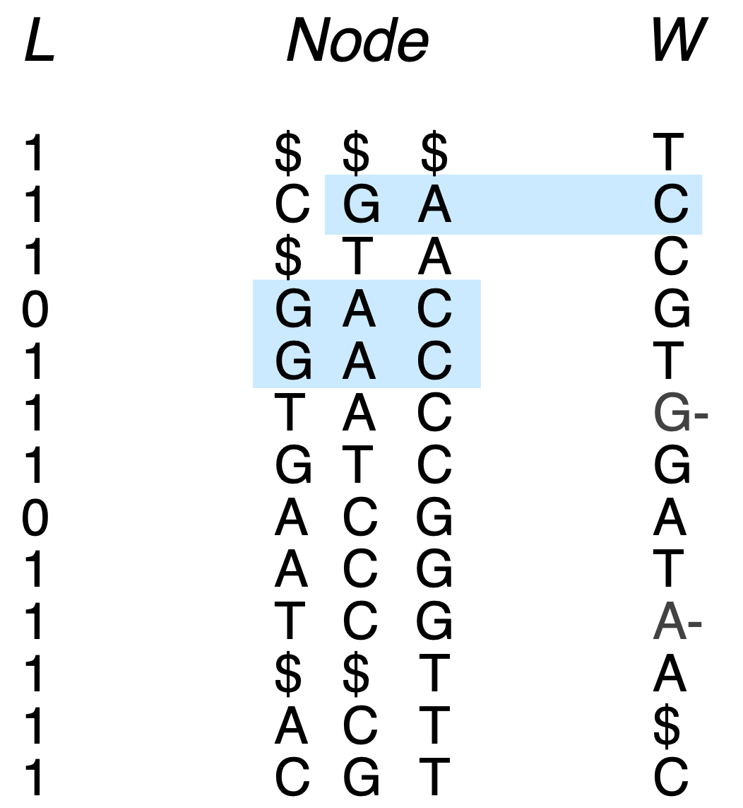
Reducing k
Notes:
Take our standard succinct dBG

Slide 21
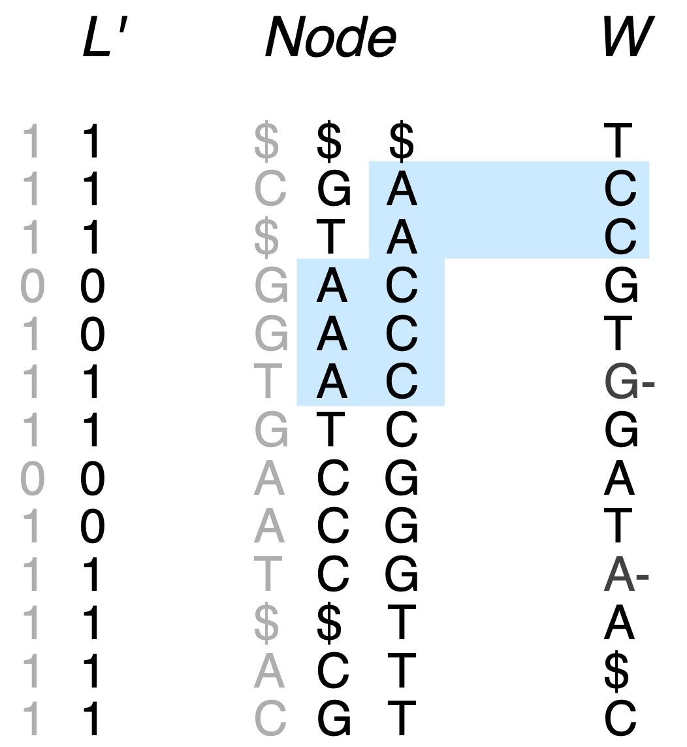
Reducing k
This should have a minus flag…
Notes:
1 sometimes becomes 0, 0 never 1, never adding anything to make it a new node

Slide 22
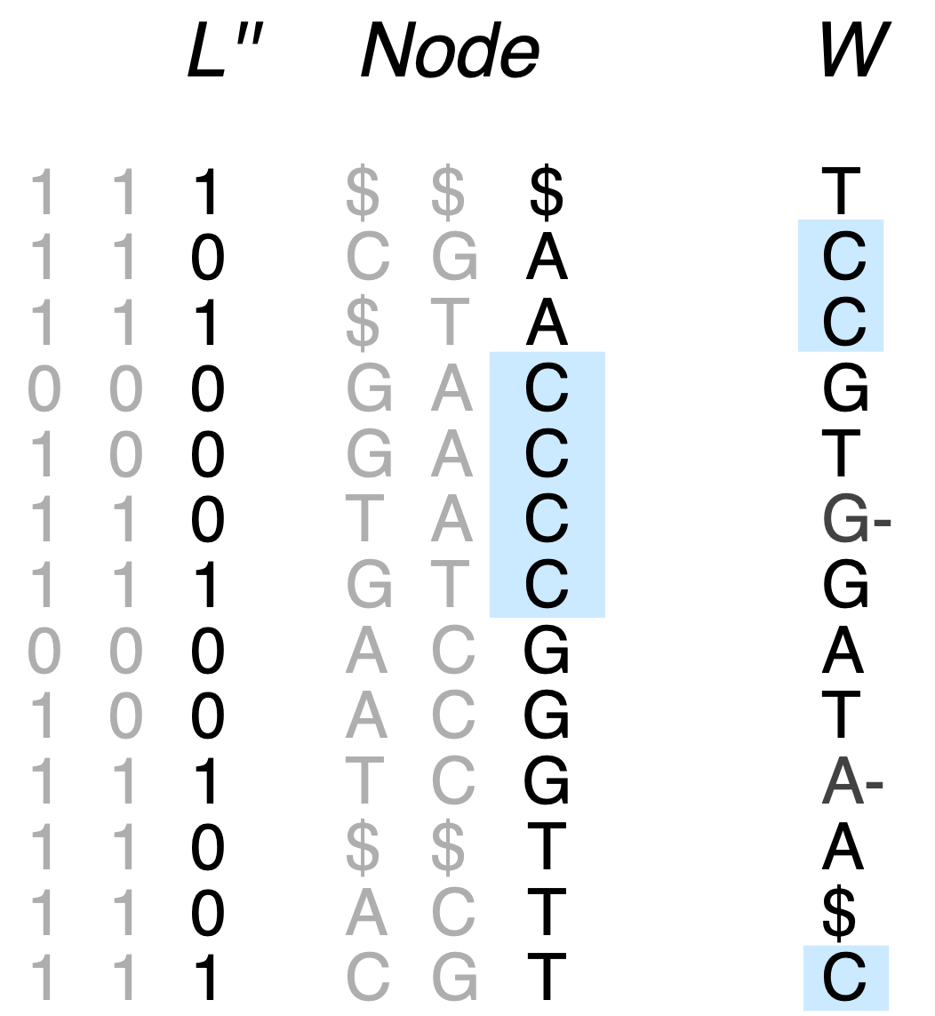
Reducing k
Notes:
Echelon form

Slide 23
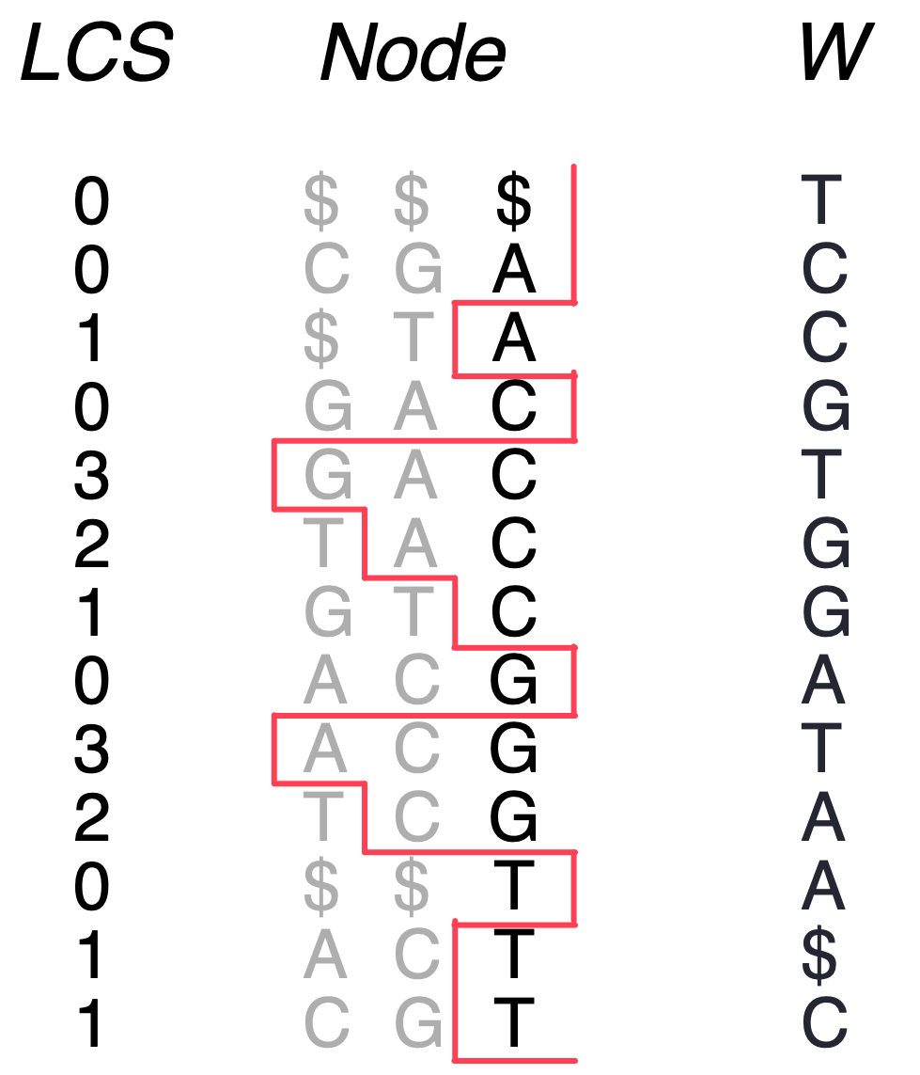
Longest Common Suffixes
m log(t) bits
for t different k values (or 2m bits w/ RMQ)
Notes:
Measures the shared suffix length with previous node

Slide 24
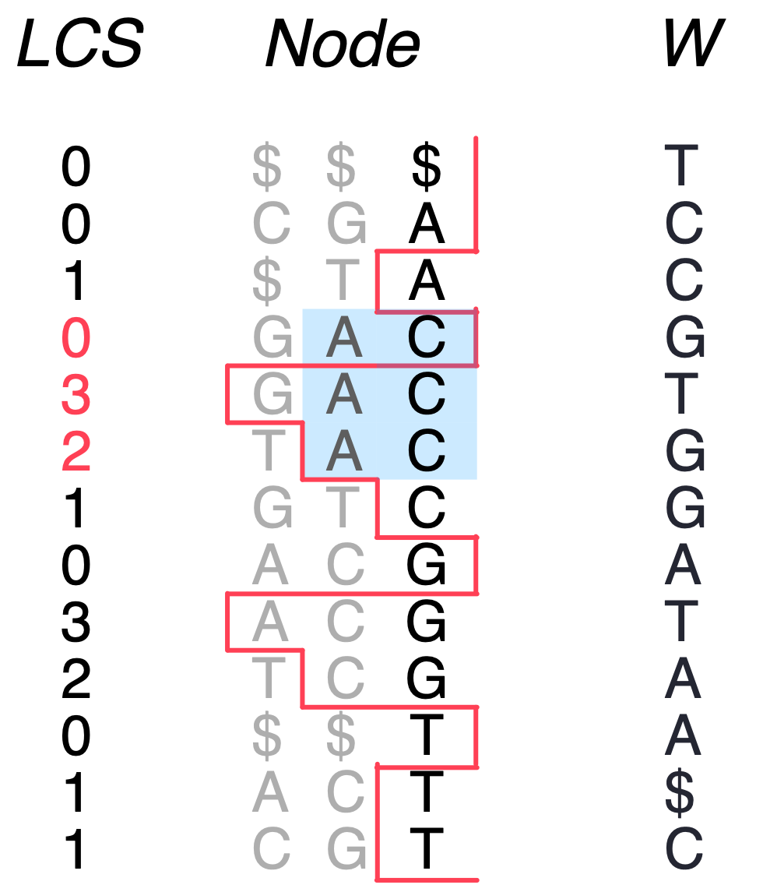
Longest Common Suffixes
Node of order k’: [start, end, k’] where LCS[start] < k’, LCS[end+1] < k’ k’ >= LCS(start, end]
m log(t) bits
for t different k values (or 2m bits w/ RMQ)
Notes:
Replaces L and minus flags
This obs the ONE thing you should remember
LCS can be discretised

Slide 25
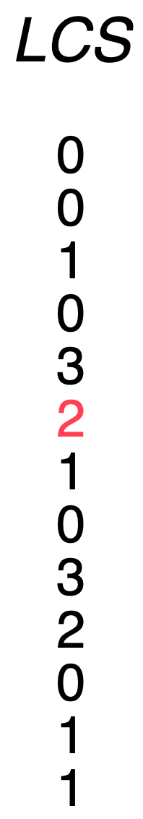
Fold
Easy to increase/decrease range if stored in Wavelet Tree
[ prev_lt(start, k’), next_lt(end, k’) )
O(log t) time
prev_lt
Fold
next_lt
Notes:
Replaces L and minus flags
This obs the ONE thing you should remember
LCS can be discretised

Slide 26
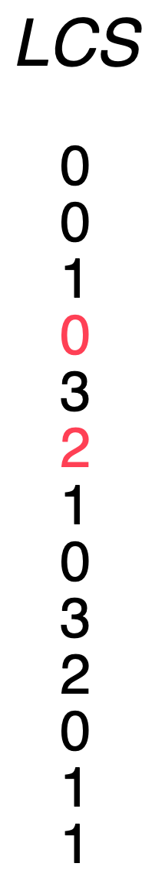
Unfold
range_lt(start, end, k’) -> P = set of positions
O(|P| log t) time
(easy to impl. using prev_lt iteratively)
range_lt
Unfold
Notes:
return a set because increasing context means we are possibly in multiple sets at once.

Slide 27
Interface
Function | Description | Complexity
shorter(v, k’) | k’-order u with k’-length suffix of v | O(log t)
longer(v, k’) | k’-order {u} with k-length suffix of v | O(|P| log t)
maxlen(v, [c]) | a max-order u with k-length suffix of v | O(1) or O(log σ)
forward(v,c) | follow edge c from v | O(log σ + log t)
backward(v) | return predecessors of v | O(σ log t)
for t different k values
Notes:
Wont go into detail, suffice it to say that forward and backward are implemented by zooming in to find… zoom back out after following the edge

Slide 28
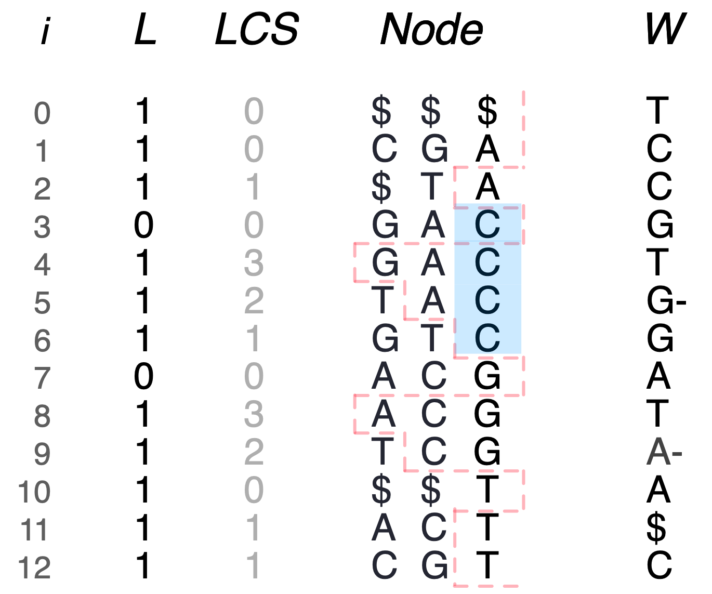
follow outgoing edge c - O(log σ + log t)
forward([i,j,k], c)
forward([3,6,1], T) ->
Notes:
so if we want to actually follow that edge but keep the same k value

Slide 29
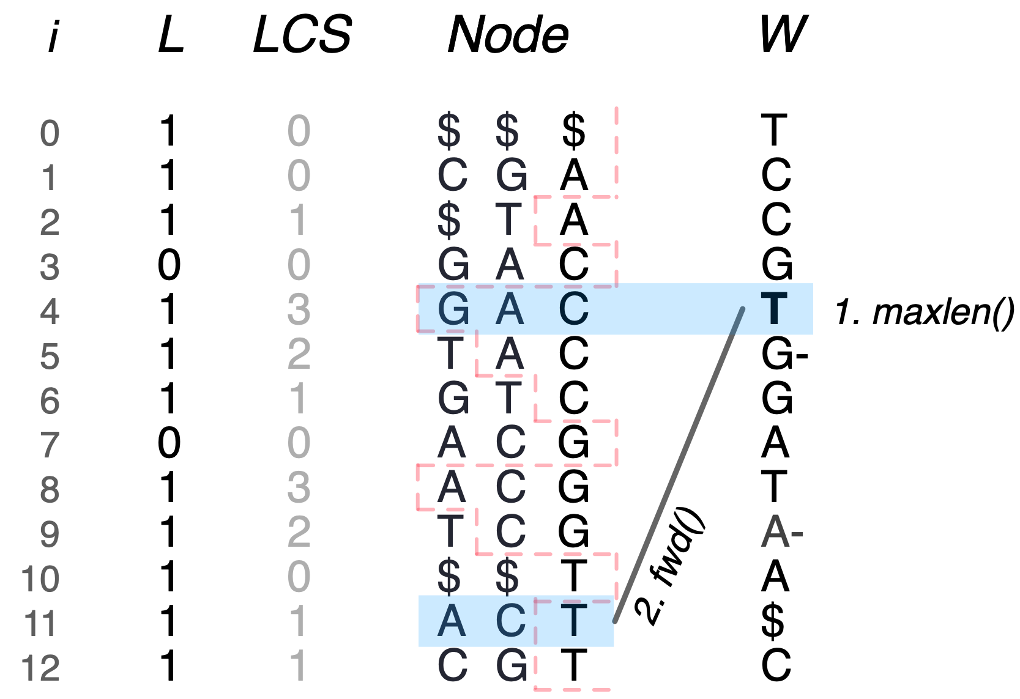
follow outgoing edge c - O(log σ + log t)
forward([i,j,k], c)
forward([3,6,1], T) ->

Slide 30
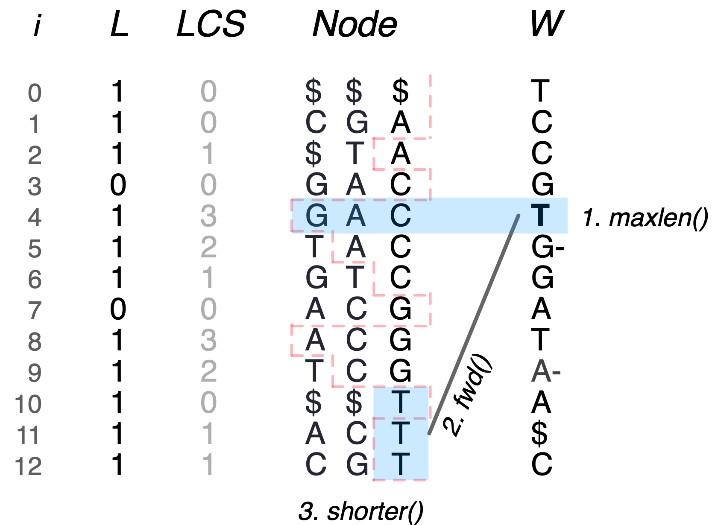
follow outgoing edge c - O(log σ + log t)
forward([i,j,k], c)
forward([3,6,1], T) -> [10,12,1]

Slide 31
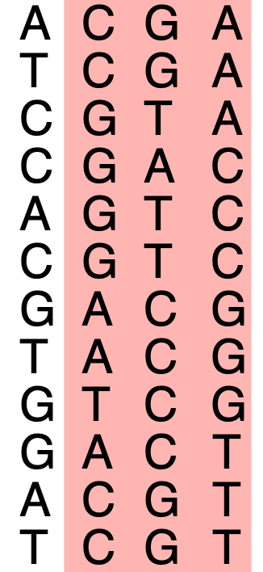
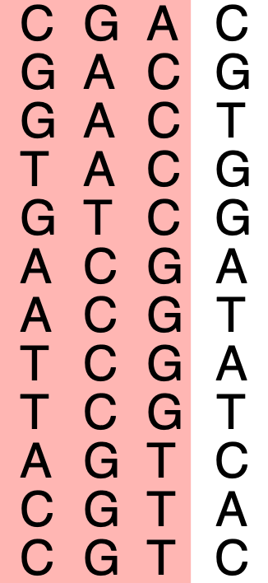
Construction
Use k-mer counter (DSK) to get unique k-mers, add reverse complements (RCs)
Colex Sort (STXXL) two copies of the table in parallel: by source node (A), target node (B)
B-A : nodes requiring outgoing dummies (colex) (= outgoing dummies in reverse lex order due to RCs). Delete B.
Generate $-shifts for incoming dummies ($ACG, $$AC, $$$A), avoiding duplicates using LCP values. Sort.
3-way merge A, O, and I, while streaming L and W, and LCS, Colour, (or any other data) to disk
can build LCP vector
B
A
Notes:
cant freq. filter because doing so might remove lower order nodes that would be of an acceptable freq.

Slide 32
Construction
Use k-mer counter (DSK) to get unique k-mers, add reverse complements (RCs)
Colex Sort (STXXL) two copies of the table in parallel: by source node (A), target node (B)
B-A : nodes requiring outgoing dummies (colex) (= outgoing dummies in reverse lex order due to RCs). Delete B.
Generate $-shifts for incoming dummies ($ACG, $$AC, $$$A), avoiding duplicates using LCP values. Sort.
3-way merge A, O, and I, while streaming L and W, and LCS, Colour, (or any other data) to disk
GTA$
ACT$
can build LCP vector
B
A
B-A
-> O

Slide 33
Construction
Use k-mer counter (DSK) to get unique k-mers, add reverse complements (RCs)
Colex Sort (STXXL) two copies of the table in parallel: by source node (A), target node (B)
B-A : nodes requiring outgoing dummies (colex) (= outgoing dummies in reverse lex order due to RCs). Delete B.
Generate $-shifts for incoming dummies ($ACG, $$AC, $$$A), avoiding duplicates using LCP values. Sort.
3-way merge A, O, and I, while streaming L and W, and LCS, Colour, (or any other data) to disk
GTA$
$TAC
ACT$
$AGT
can build LCP vector
B
A
B-A
RC(B-A) = A-B
-> O
-> I

Slide 34
Construction
Use k-mer counter (DSK) to get unique k-mers, add reverse complements (RCs)
Colex Sort (STXXL) two copies of the table in parallel: by source node (A), target node (B)
B-A : nodes requiring outgoing dummies (colex) (= outgoing dummies in reverse lex order due to RCs). Delete B.
Generate $-shifts for incoming dummies ($ACG, $$AC, $$$A), avoiding duplicates using LCP values. Sort.
3-way merge A, O, and I, while streaming L and W, and LCS, Colour, (or any other data) to disk
colex
GTA$
$TAC
ACT$
$AGT
can build LCP vector
reverse lex
B
A
B-A
RC(B-A) = A-B
-> O
-> I

Slide 35
Construction
Use k-mer counter (DSK) to get unique k-mers, add reverse complements (RCs)
Colex Sort (STXXL) two copies of the table in parallel: by source node (A), target node (B)
B-A : nodes requiring outgoing dummies (colex) (= outgoing dummies in reverse lex order due to RCs). Delete B.
Generate $-shifts for incoming dummies ($ACG, $$AC, $$$A), avoiding duplicates using LCP values. Sort.
3-way merge A, O, and I, while streaming L and W, and LCS, Colour, (or any other data) to disk
colex
GTA$
$TAC
$$AG
$AGC
ACT$
$AGT
can build LCP values
reverse lex
B
A
B-A
RC(B-A) = A-B
-> O
-> I
Notes:
measure shared prefix length to avoid duplication
Only need one copy of satellite data (A)

Slide 36
Construction
Use k-mer counter (DSK) to get unique k-mers, add reverse complements (RCs)
Colex Sort (STXXL) two copies of the table in parallel: by source node (A), target node (B)
B-A : nodes requiring outgoing dummies (colex) (= outgoing dummies in reverse lex order due to RCs). Delete B.
Generate $-shifts for incoming dummies ($ACG, $$AC, $$$A), avoiding duplicates using LCP values. Sort.
3-way merge A, O, and I, while streaming L and W, and LCS, Colour, (or any other data) to disk
colex
GTA$
$TAC
$$AG
$AGC
ACT$
$AGT
can build LCP vector
reverse lex
B
A
B-A
RC(B-A) = A-B
-> O
-> I
Notes:
measure shared prefix length to avoid duplication
Only need one copy of satellite data (A)

Slide 37
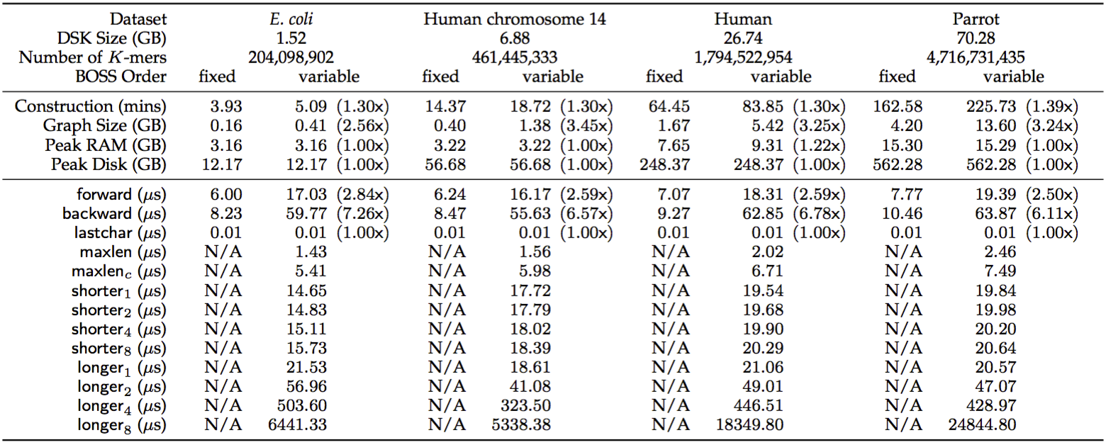
Results
longer_1 + 4(maxlen + backward + shorter)
+ log t
shorter is stable
nodes increase exponentially (10 microsec per node)
Notes:
30% from WT
Most algorithms dont use backward anyway
rest is pretty good (better than t)

Slide 38
Coloured
de Bruijn Graphs
Martin D. Muggli, Alex Bowe, Travis Gagie, Robert Raymond, Noelle R. Noyes, Paul Morley, Keith Belk, Simon J. Puglisi and Christina Boucher
Notes:
dropped decodable debruijn sequences, but still interested in doing this

Slide 39
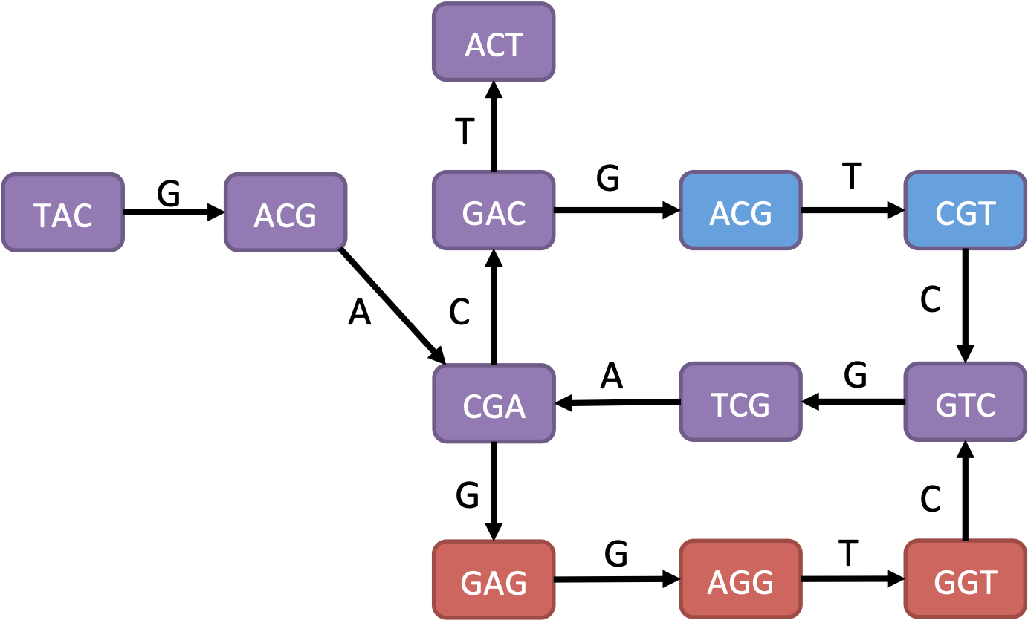
Coloured De Bruijn Graphs
[Iqbal et al. 2012]
Goal: Improve variant detection with (unassembled) genomes in a massive population.
Motivation: pangenomic data increasing rapidly. Individual assemblies remove structure, takes time/memory.
SNP
T = TACGACGTCGACT
S = TACGAGGTCGACT
TACG
GACG
CGAG
ACGA
CGAC
GAGG
ACGT
GTCG
TCGA
AGGT
CGTC
GACT
GGTC
4-mers
graph
Recent survey: “Computational pan-genomics: status, promises and challenges”, Briefings in Bioinf., Oct 21
Notes:
here I’ve introduced another sample which has a single SNP
Cortex: 2 algorithms… find branch, split by specified colours…

Slide 40
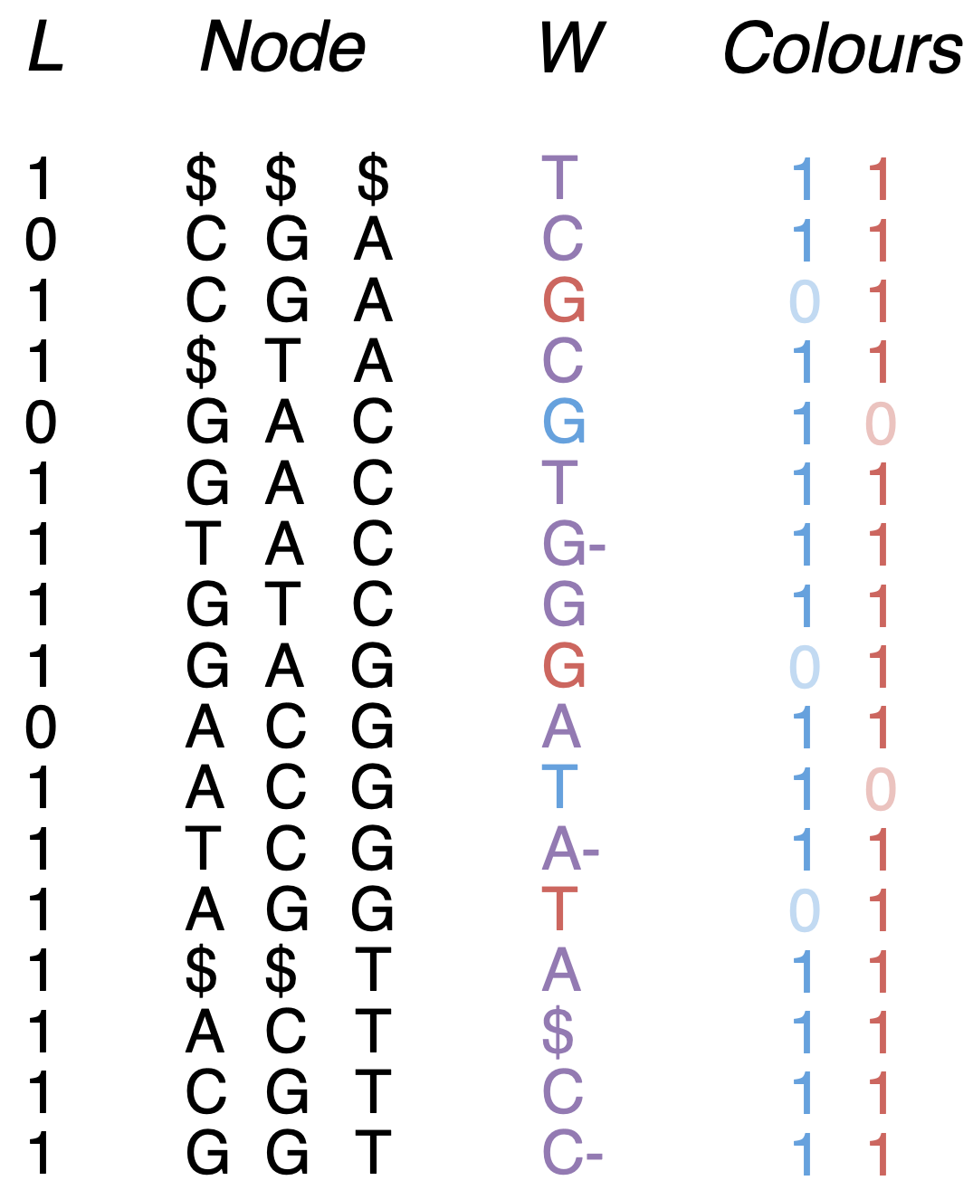
Our Representation
Construction: - C-way merge of k-mer counter outputs - Follow previous construction, writing matrix to disk - Build sparse bit matrix (row major) by streaming
4 + C + o(1) bits per edge
Cortex: 64 + 32C bits per edge
Notes:
Really simple, but the varied construction algorithm helped make it
access any colours in O(1), all colours in row in O(C)
mostly 1s - sparse
(4+C)m bits vs C4m bits

Slide 41
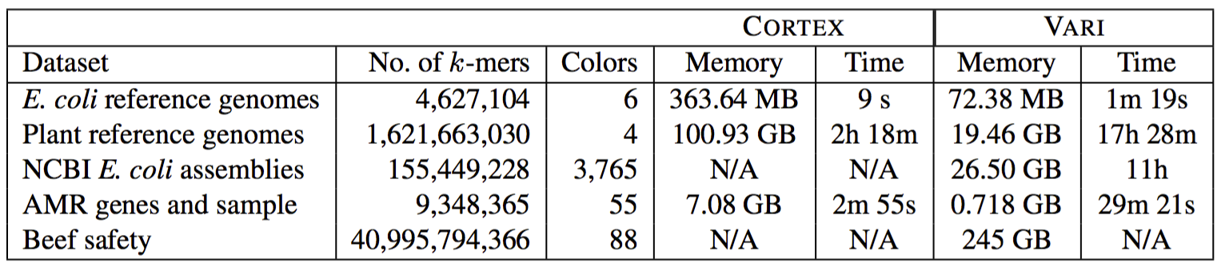
Results: Bubble calling
Bubble Calling: Traverse each node to find start and end nodes of bubble (outdegree 2, ends up at same node). If different colour arcs: variant.
from original paper
+ AMR
All known AMR genes (in 1 colour)
3+TB
18+TB
est. 3000 hours… Did another experiment instead
Notes:
Beef supply chain stages

Slide 42
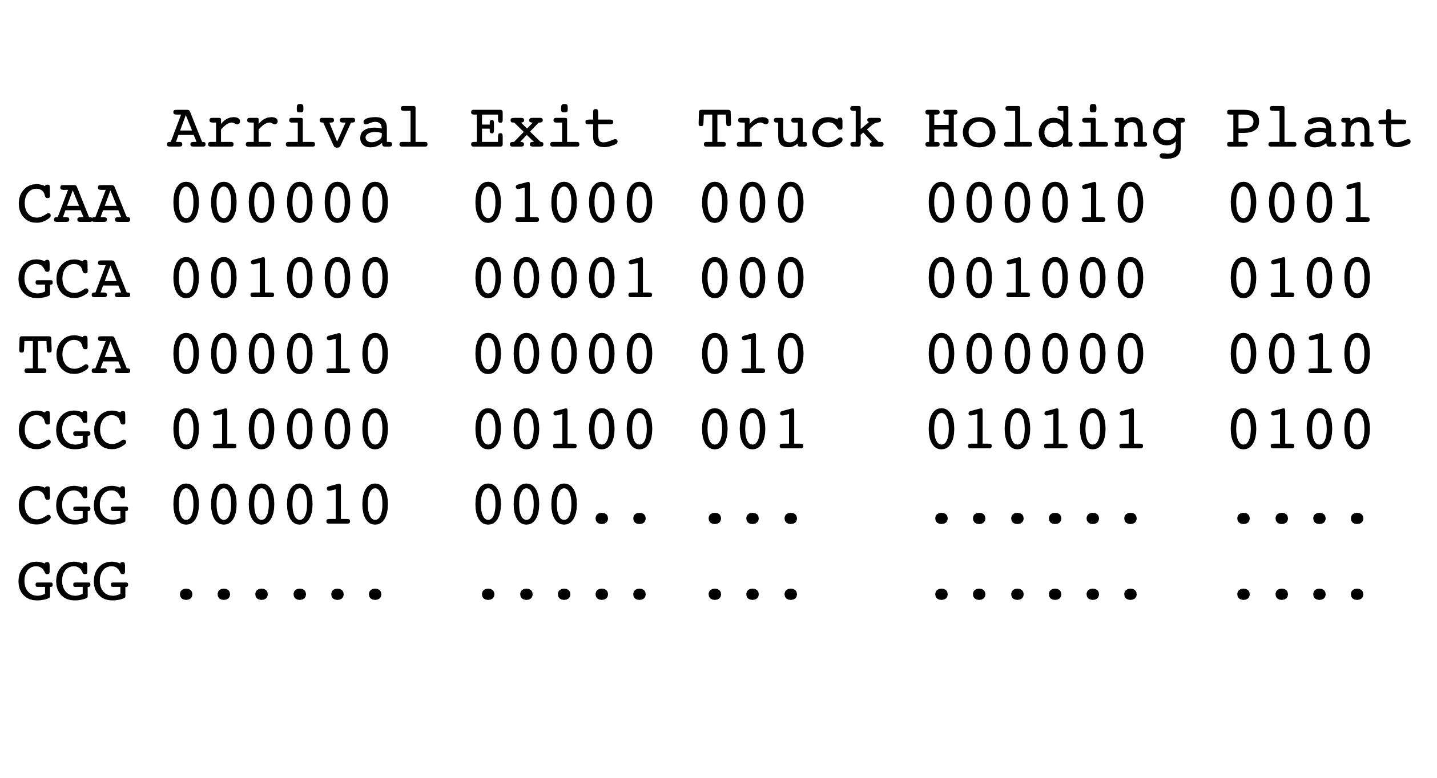
Grouped Rows
Comparing populations in multiple samples: If we sort the samples by time and group by stage, can find how many samples a k-mer appears in with 2 rank queries per group.
rank
rank
Notes:
A nice feature of row major
Such as stages in a beef supply chain

Slide 43
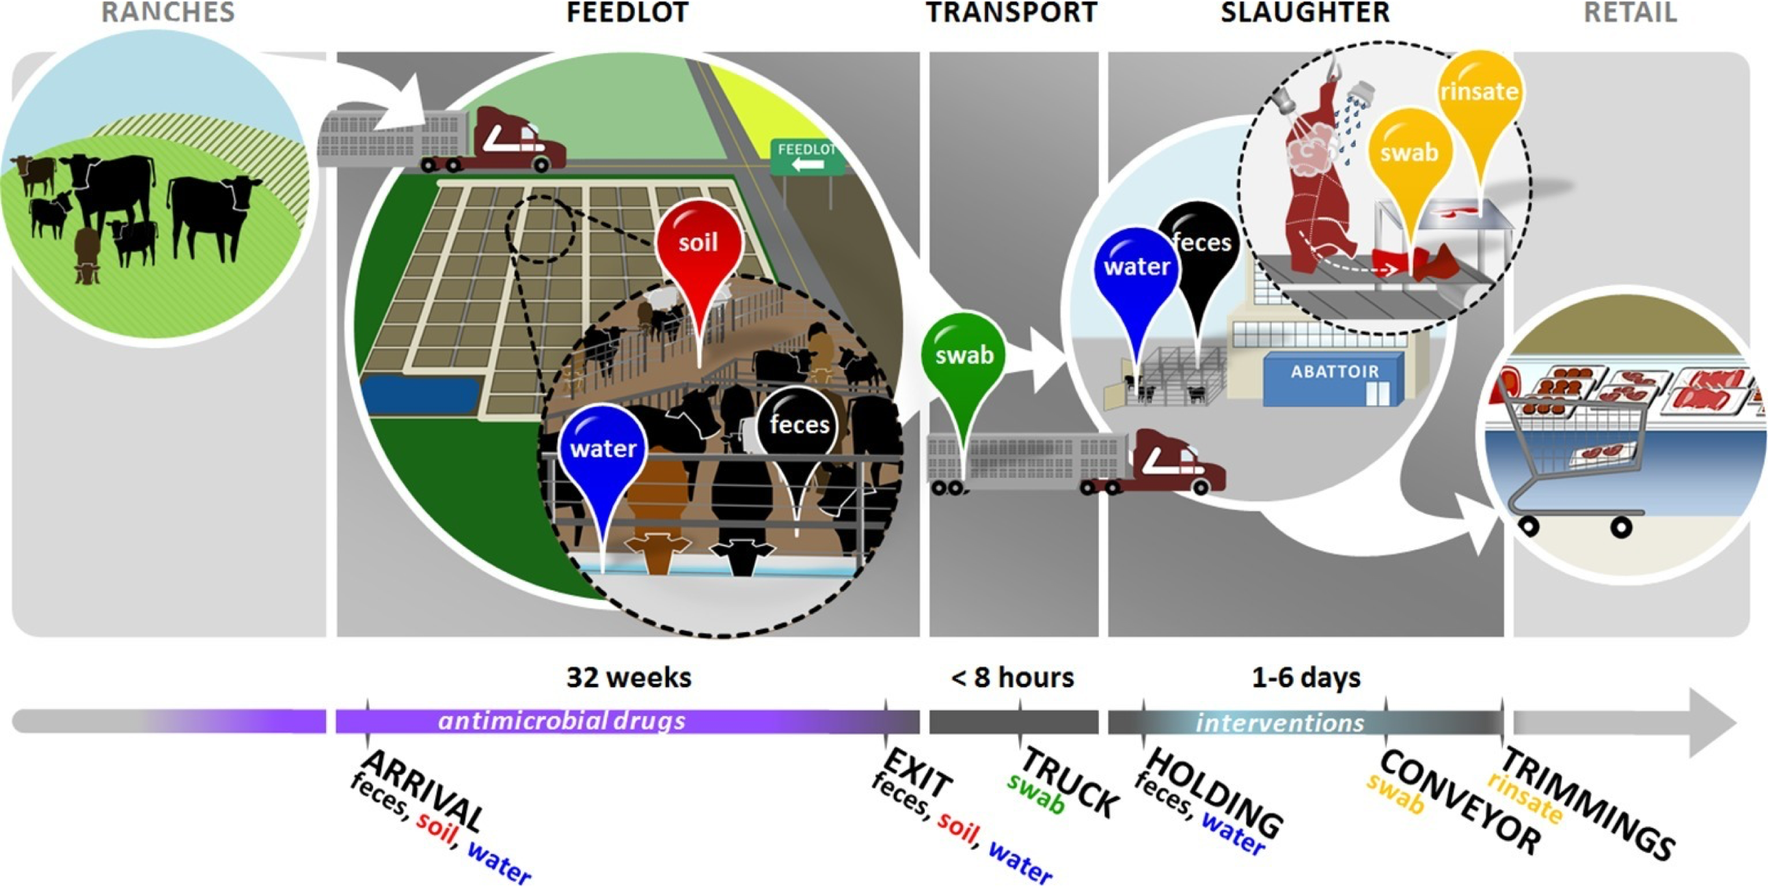
Beef Safety/AMR
Approach: Traverse AMR graph using AMR genes as guide, count # of AMR genes (27 min)
Hypothesis: Antimicrobial interventions at slaughter were effective.
# AMR genes with high k-mer freq:
304
93
230
16
0
Notes:
- avoid allowing it to evolve
- Using beef reads as a guide, but canceling whenever we deviated from AMR

Slide 44
Summary
Compact dBG (2 bits per edge), first BWT approach
Variable Order dBG
3.5x size, 30% slower to build, 3x slower to traverse
New traversal methods. (Faster than IDBA?)
New: coloured de Bruijn graph
slower, but 3TB -> 26.5 GB (e. coli), 18TB -> 245GB (beef safety)
Looking at colour per read, which is useful in some applications
New: fast external construction
Code: github.com/cosmo-team/cosmo

Slide 45
Thank you

Slide 46
What’s next?
TRAVERSAL
dead end: shorter
branch: longer
Frequency filtering; had to include all kmers - removing low frequency kmers might remove high frequency (k-1)-mers
Application note by Feb
Reads
Notes:
- corresponds to these incoming edges
- distinguishing these is important for later operations

Slide 47
What’s next?
TRAVERSAL
dead end: shorter
branch: longer
Frequency filtering; had to include all kmers - removing low frequency kmers might remove high frequency (k-1)-mers
Application note by Feb
Reads
shorter
Notes:
Can probably find least branchy in log d time?
Can we do this by removing edges (preprocessing)? find all dummy edges, shorten them until one row, then…

Slide 48
What’s next?
TRAVERSAL
dead end: shorter
branch: longer
Frequency filtering; had to include all kmers - removing low frequency kmers might remove high frequency (k-1)-mers
Application note by Feb
Reads
longer
Notes:
Use traversal history to determine prefix
(longer can be sped up?)
(preprocessing?)

Slide 49
fwd() & bwd()
Function | Description | Complexity
fwd(i) | Return index of last (L = 1) edge of node pointed to by edge i | O(1)
bwd(j) | Return index of first (no minus) edge that points to the node that edge j leaves | O(1)
Notes:
defined over edges - fwd -> last edge of the destination node (1)
- bwd -> from 1, first predecessor edge (no minus)

Slide 50
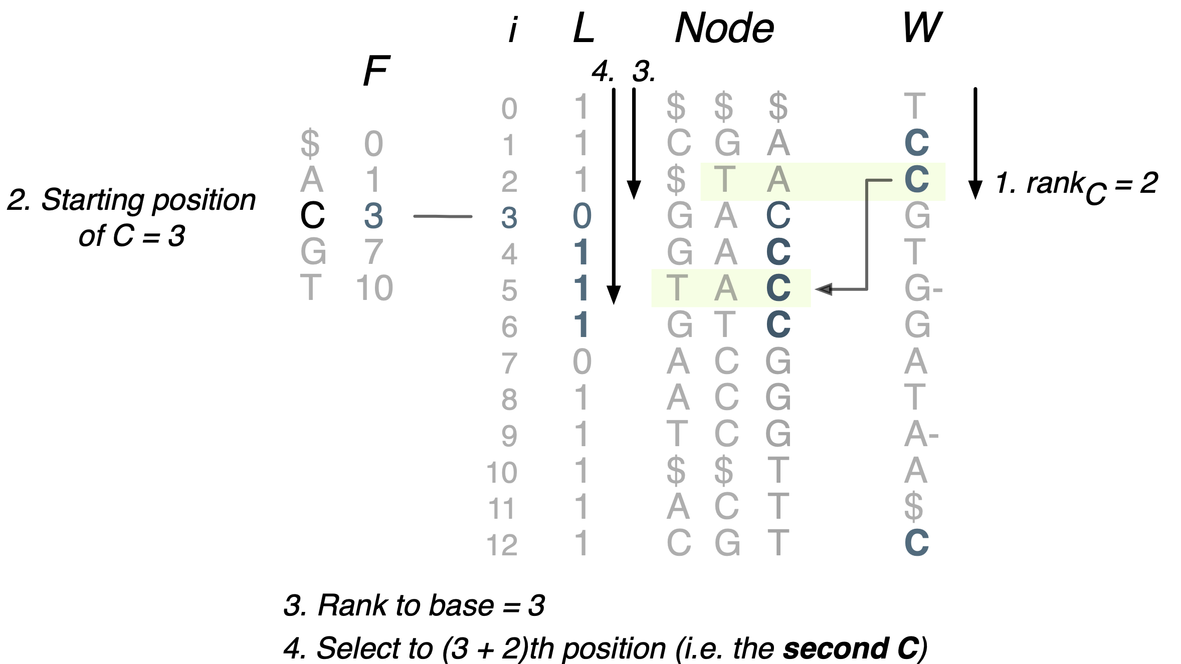
Example: fwd(2)
Notes:
bwd is done in a similar fashion, but going from F to W instead.

Slide 51
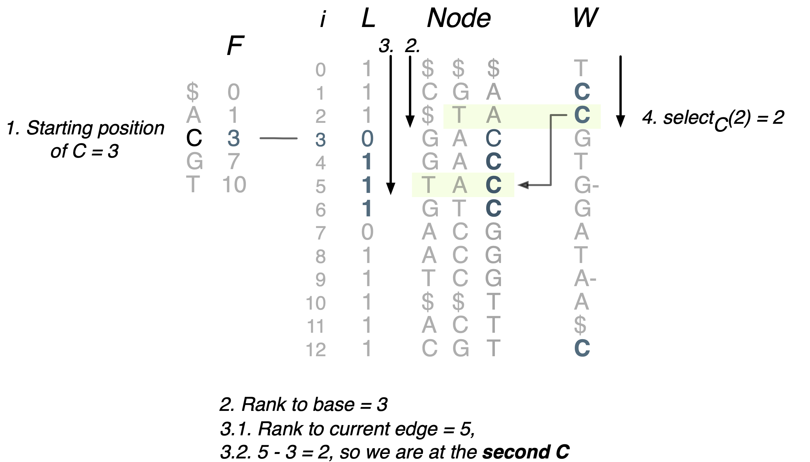
Example: bwd(5)
Notes:
bwd is done in a similar fashion, but going from F to W instead.

Slide 52
BWT
Burrows Wheeler Transform
Permute letters in a string in lexicographic order of their reversed prefixes (‘colex’ order)
Size: nH_{k}(T) ≤ n log σ H_{k}: k-th entropy of T
Using only W, search and decode are possible
Prefix
W
$
$TACGA
$TACGACGTCGA
$TA
$TACGAC
$TACGACGTCGAC
$TAC
$TACGACGTC
$TACGACG
$TACG
$TACGACGTCG
$T
$TACGACGTCGACT
$TACGACGT
T
C
C
C
G
T
G
G
T
A
A
A
$
C
T = $TACGACGTCGACT

Slide 53
XBW
Sort (colexically) path-labels from root to each node
Add some bit vectors to represent the tree shape…
Tree traversal and path-label search are done efficiently
Size: m(2+H_{k}(T)) bits
H_{k}: k-th entropy of path labels
m: number of edges
leaf
T
last
Path Label
W
0
0
0
1
1
0
0
0
0
1
T
C
C
G
T
G
A
T
A
C
0
1
1
0
1
1
0
1
1
1
$
$TACGA
$TA
$TACGAC
$TACGAC
$TAC
$TACG
$TACG
$T
$TACGT
A
C
G
A
T
C
C
G
T
Notes:
- inspired our impl.

Slide 54
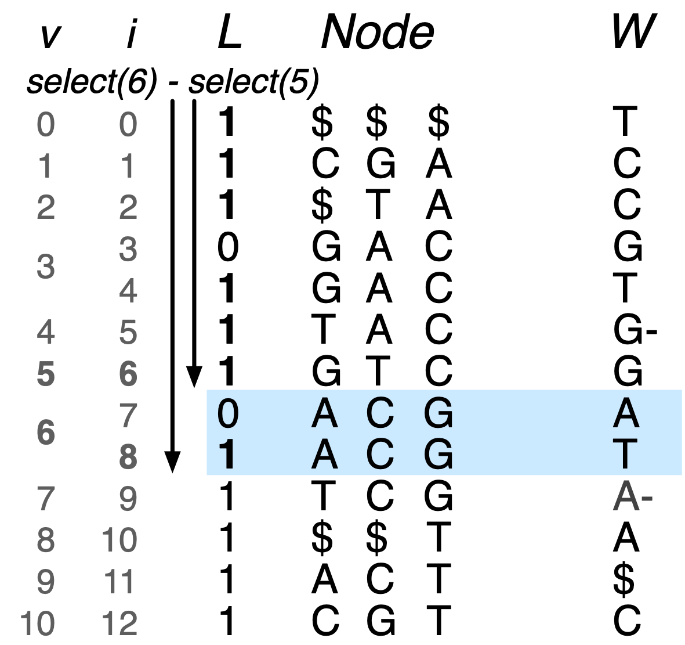
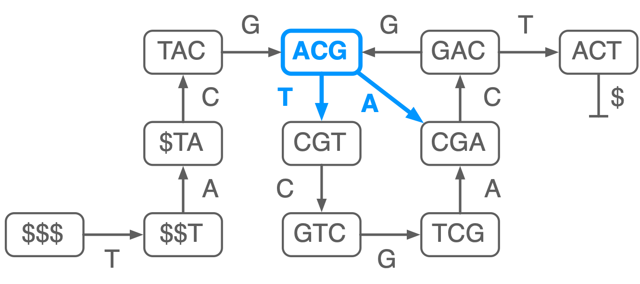
outdegree(v)
# outgoing edges - O(1)
All outgoing edges are contiguous
last: 0*1
Count zeros, add one...
select1(L, v) - select1(L, v-1)
outdegree(6) = 2
Notes:
- find the difference between positions of 1s

Slide 55
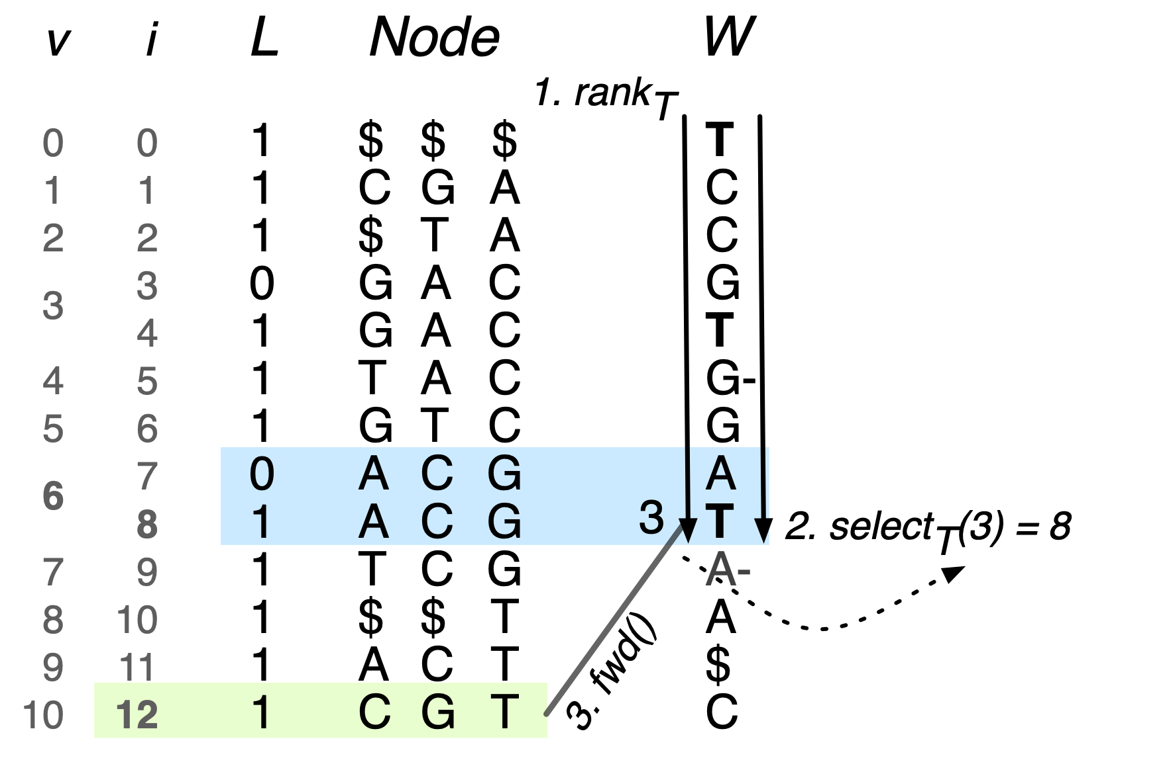
outgoing(v, c)
follow edge c from v - O(1)
Search outgoing edges for c or c⁻
select(rank(i)): position of last occ. in the range [0,i]
x = selectc(W, rankc(W, v))
if not in outgoing-edge range (known from outdegree) try c⁻
return fwd(x)
outgoing(6, T)
Notes:
idea: find node 6 row (select) to last row
select a rank: find position of last in that range

Slide 56
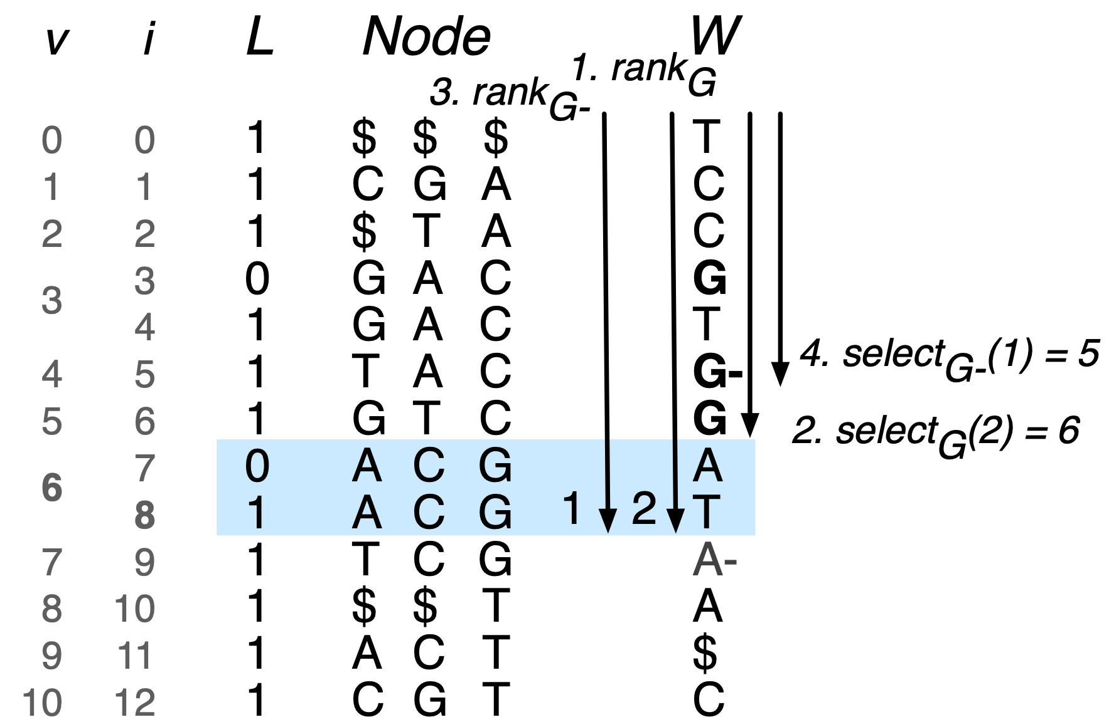
outgoing(v, c)
follow edge c from v - O(1)
outgoing(6, G) - no outgoing G or G- edge
Notes:
first rank and select to find G, no G...

Slide 57
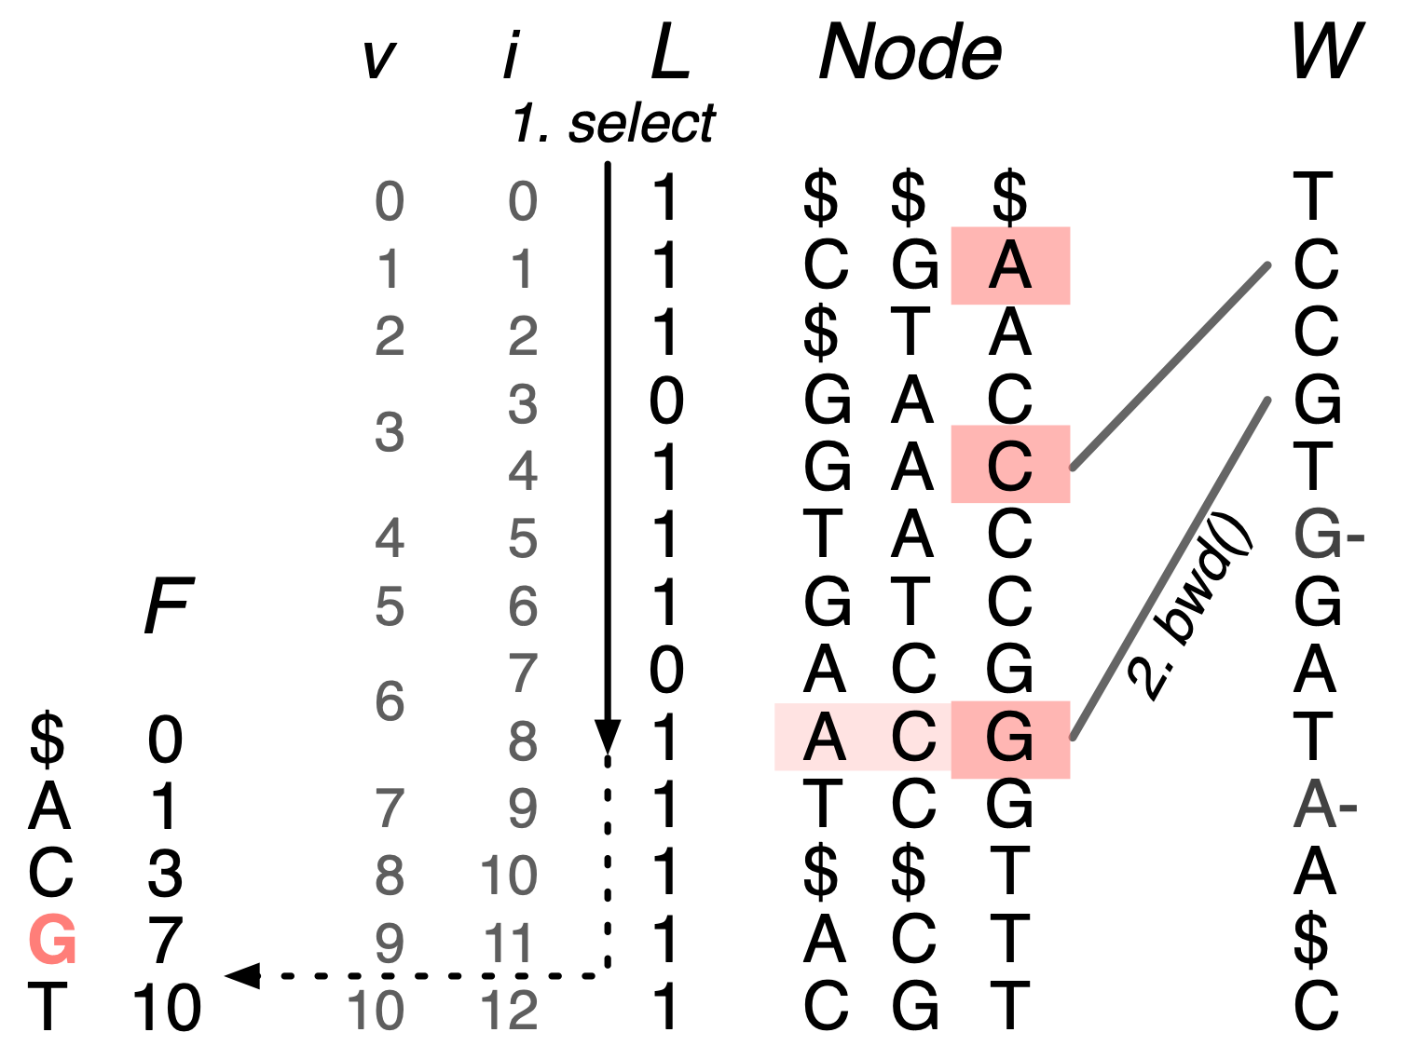
node(v)
return label of v - O(k)
Reminder: Node[] not stored, but last (kth) letter is stored in F.
Calculate bwd() k times, using resulting indexes to reverse lookup in F.
Notes:
- select over last to find index, then find F_inv(i)
- assume F_inv O(1) lookup?

Slide 58
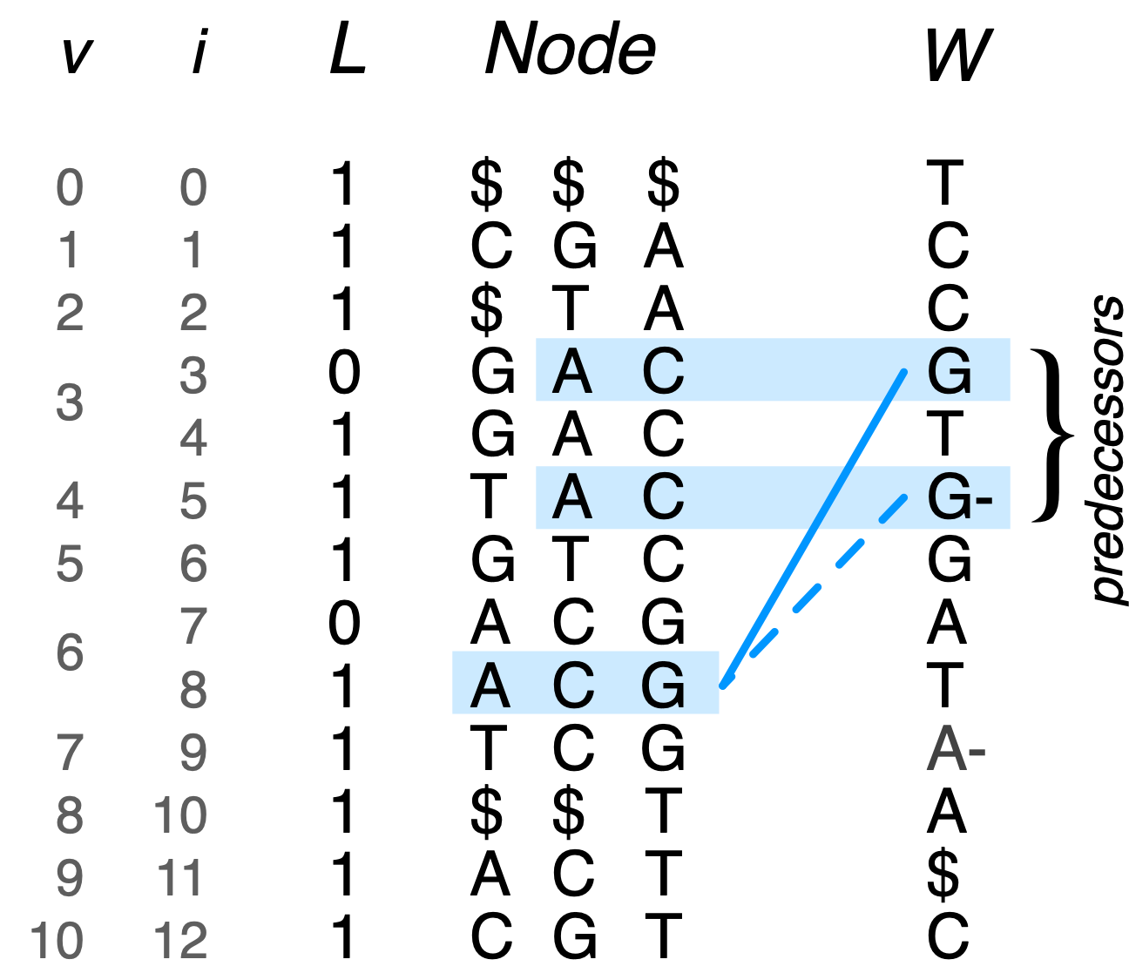

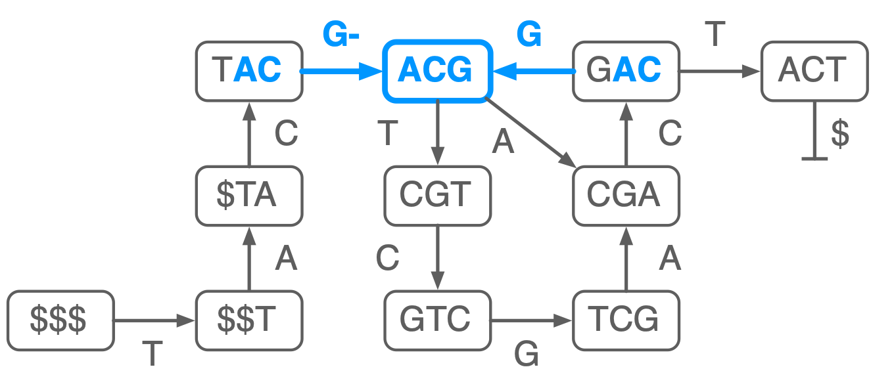
indegree(v)
# incoming edges - O(1)
use bwd() to give us first predecessor node
if there are more, they sort after as c-
rank/select to next c, subtract ranks of c- to find degree
indegree(6) = 2
Notes:
- rank how many Gs before,
- select the next G
rank the number of G-s in between

Slide 59
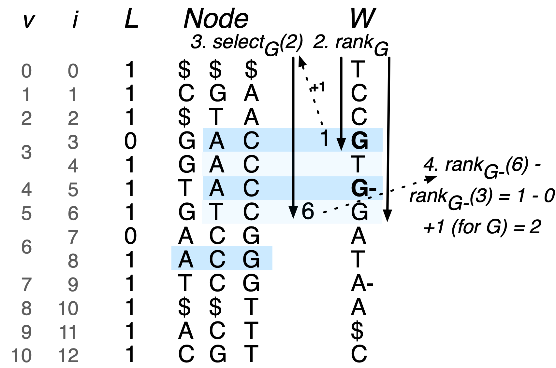
indegree(v)
# incoming edges - O(1)
x = rank to count previous c edges
select(x+1) finds next c edge
rank c- to count occurrences between

Slide 60
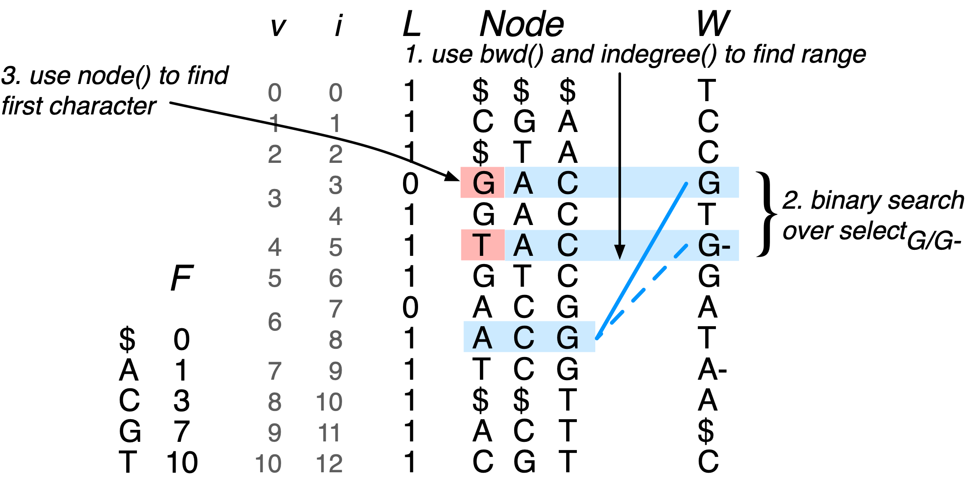
incoming(v, c)
predecessor of v starting with c - O(k log σ)
Similar to indegree() to locate predecessors
These nodes differ only in their first character, and are sorted
Can use node() to find first character - O(k)
binary search: O(log σ) time

Slide 61
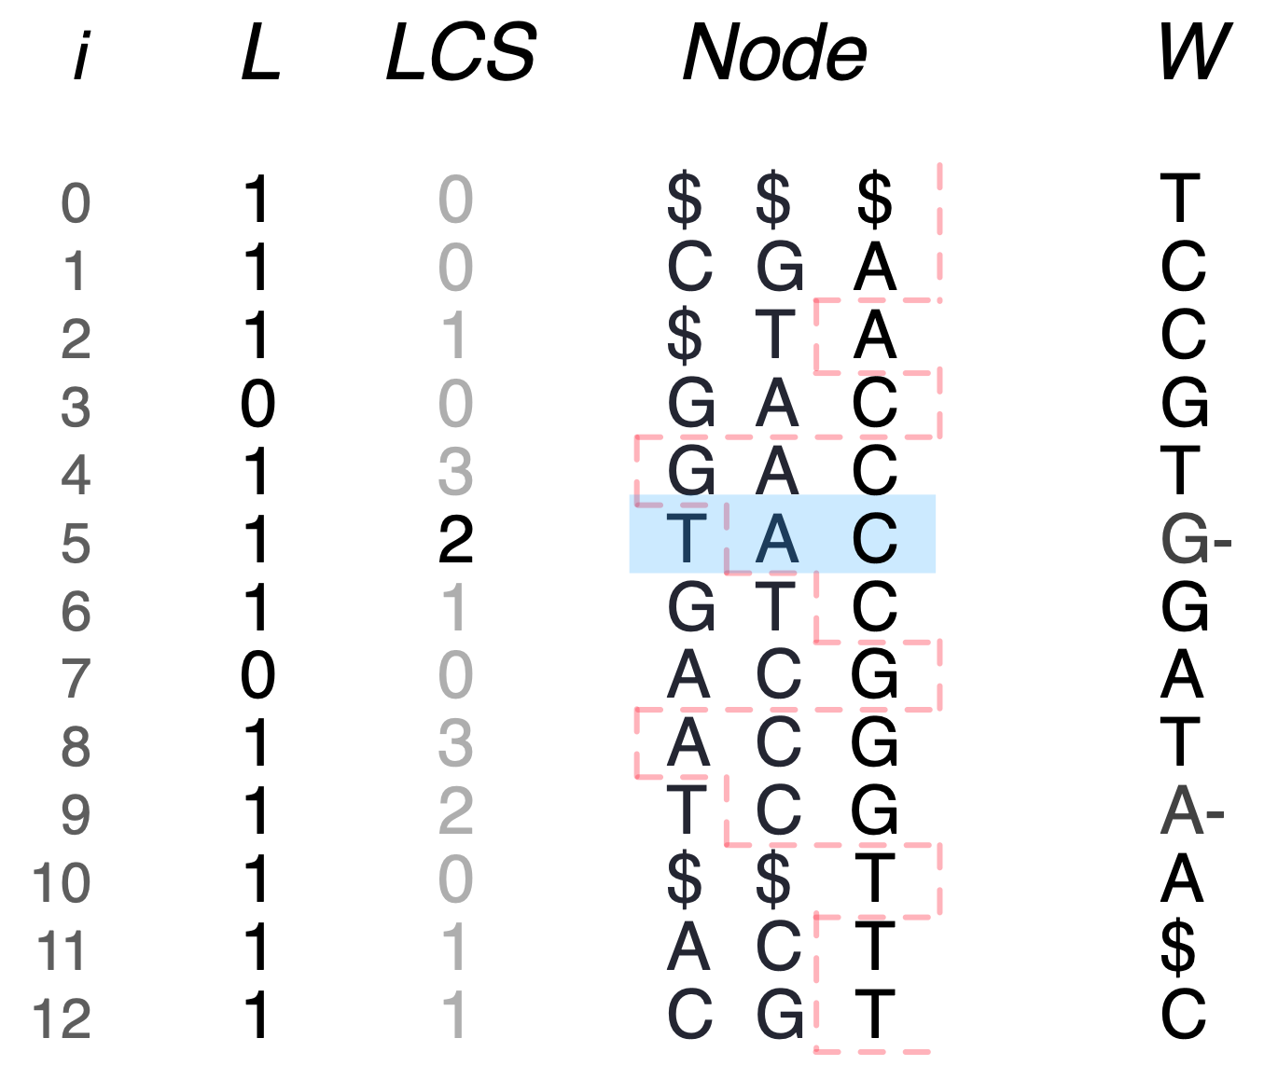
node [i’, j’, k’] - O(log d)
shorter([i,j,k], k’)
-> [prev_lt(LCS, i, k’), next_lt(LCS, j, k’)-1, k’]
shorter([5,5,3], 1) ->
Notes:
Wavelet tree -> O(log d)

Slide 62
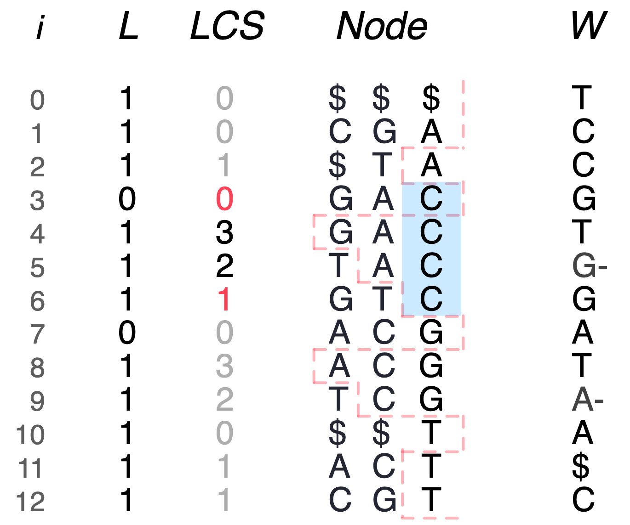
node [i’, j’, k’] - O(log d)
shorter([i,j,k], k’)
-> [prev_lt(LCS, i, k’), next_lt(LCS, j, k’)-1, k’]
shorter([5,5,3], 1) -> [3,6,1]
Notes:
Some corner cases, but thats the basic idea

Slide 63

{ node [i’, j’, k’] } - O(|B| log d)
longer([i,j,k], k’)
-> { [i’,j’,k’] | i’,j’ consecutive pairs in range_lt(LCS,i,j,k’) ]
longer([3,6,1], 3) ->
Notes:
B is the set of nodes that have the same suffix
this will make sense

Slide 64
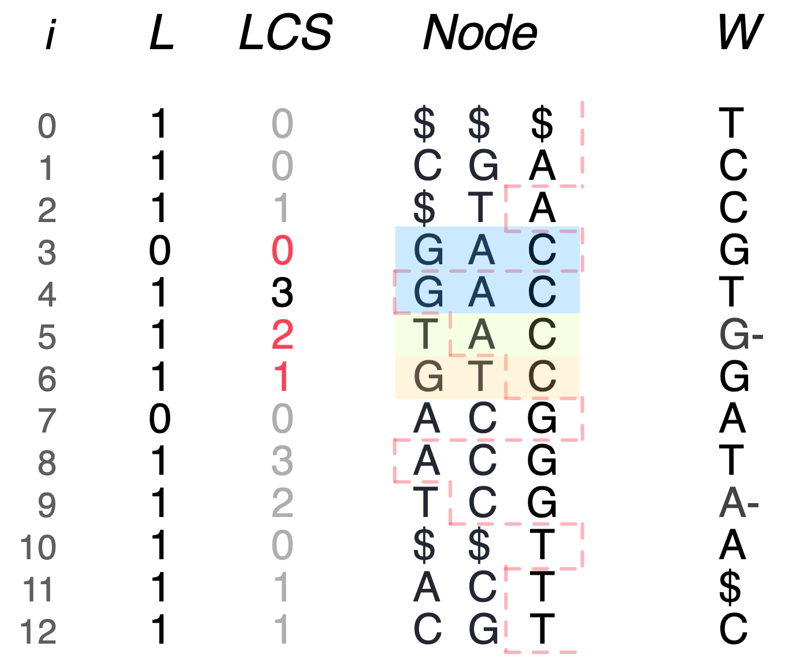
{ node [i’, j’, k’] } - O(|B| log d)
longer([i,j,k], k’)
-> { [i’,j’,k’] | i’,j’ consecutive pairs in range_lt(LCS,i,j,k’) ]
longer([3,6,1], 3) -> { [3,4,3], [5,5,3], [6,6,3] }
Notes:
|B| = 3
but can increase exponentially (prefix of node label)

Slide 65
max length node, optionally with c edge - O(1) or O(log σ)
maxlen([i,j,k], c)
maxlen([3,6,1], 3) ->
Notes:
we support fwd and bwd using a function called maxlen

Slide 66
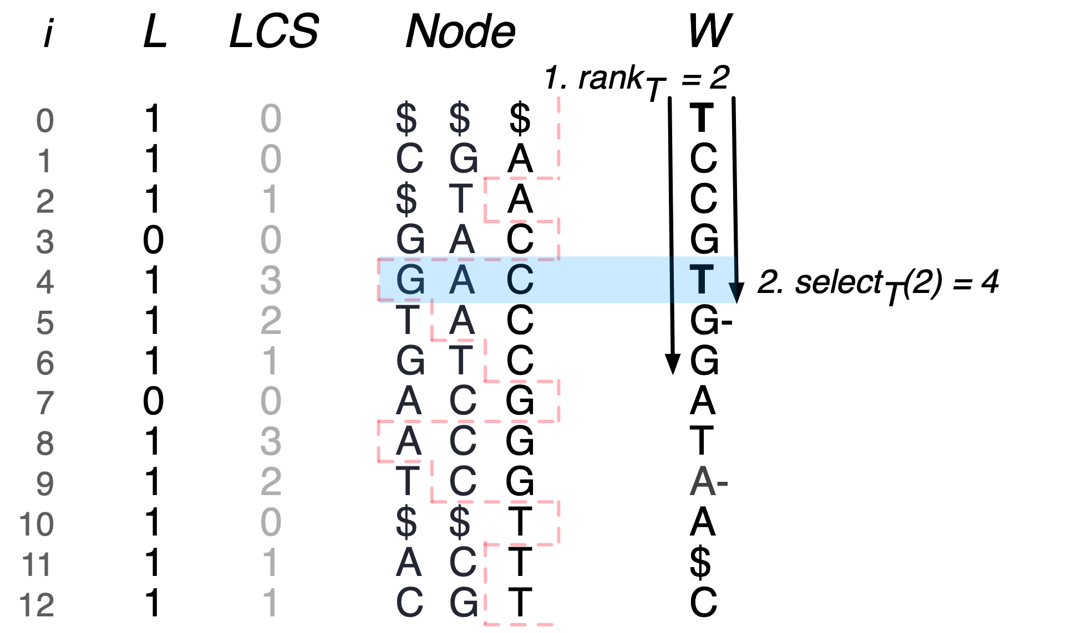
max length node, optionally with c edge - O(log σ)
maxlen([i,j,k], c)
maxlen([3,6,1], 3) -> [4,4,3]
Notes:
If we dont care about c, dont rank/sel - O(1)
Can easily return node if needed (3,4), but we dont need it.

Slide 67
follow outgoing edge c - O(log σ + log d)
forward([i,j,k], c)
forward([3,6,1], T) ->
Notes:
we support fwd and bwd using a function called maxlen

Slide 68
follow outgoing edge c - O(log σ + log d)
forward([i,j,k], c)
forward([3,6,1], T) ->
Notes:
we support fwd and bwd using a function called maxlen

Slide 69
follow outgoing edge c - O(log σ + log d)
forward([i,j,k], c)
forward([3,6,1], T) -> [10,12,1]
Notes:
we support fwd and bwd using a function called maxlen

Slide 70

predecessors - O(σ log d)
backward([i,j,k])
backward([3,6,1]) ->

Slide 71

predecessors - O(σ log d)
backward([i,j,k])
backward([3,6,1]) ->

Slide 72

predecessors - O(σ log d)
backward([i,j,k])
backward([3,6,1]) ->

Slide 73

predecessors - O(σ log d)
backward([i,j,k])
backward([3,6,1]) ->

Slide 74

predecessors - O(σ log d)
backward([i,j,k])
backward([3,6,1]) -> {[1,2,1], [10,12,1]}

